Slide 1
Episcopal Relief & Development
Communities of Learning
Contributed by Kathy Bozutti-Jones and Jamie Martin-Currie

Slide 2
Introduction
This four-session curriculum is intended for small group gatherings, online or in person. The objective is to help participants to grow in awareness of, and desire to serve, the populations and priorities aligned with the mission of Episcopal Relief & Development. As a faith formation curriculum, it offers group support and asks participants to be open to where God may be leading, in terms of how to grow in empathy and to respond to your new learnings in daily living. We know that our strengths come from pursuit of the things we are interested in and, so, we trust that our strengths relative to this good work will be revealed in the prayerful learning process.
Notes:
Leader: Read or paraphrase introduction.

Slide 3
Prayer
We ask you, loving God, to open our eyes to what is happening in communities at risk around the world. Guide us as we review the transformative responses of Episcopal Relief & Development.
Open our hearts to see where we might feel led to be of service, too. Amen.
Notes:
Leader: Invite participants to join in the prayer.

Slide 4
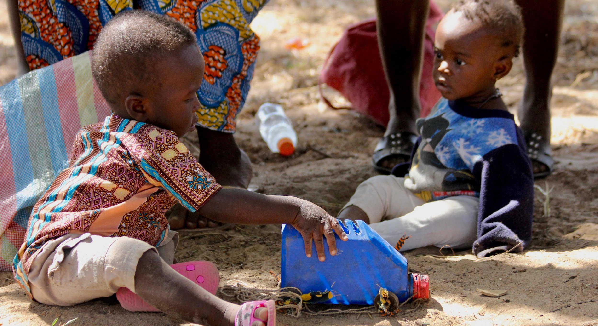
Group Rule of Life
Group Prayer
Guided Meditation
Intercessory Prayer at Home
Notes:
Leader: Explain that there are three ways in which the learning community will commit to a rule of life during the sessions. In other words, the sacred context of each session is understood to include prayer and meditation, together and at home.

Slide 5
Episcopal Relief & Development Priorities for Children
Every child deserves the chance to achieve their full potential. Research shows that the first 1,000 days are foundational, affecting a child’s capacity to grow, learn and thrive over his or her entire life. The first few years form the basis for future learning, good health and nutrition and overall well-being.
Notes:
Leader: This session begins with a description of our topic. Read aloud or invite a reader.

Slide 6
Opening Prayer - Youth session
We ask your blessing on this learning community, Loving God, that we may be attentive to the movements of your Spirit. Guide us as we grow to understand how we might participate in the global priorities of Episcopal Relief & Development to empower women, nurture children, and meet the challenges of climate change and disaster resilience. We offer to you our open hearts and our desire to promote the dignity of all people. In your name we pray. Amen.
Notes:
Leader: In this Ritual of Dedication, invite online participants to light a candle, take some deep breaths, and pray the opening prayer aloud, together. (“Let us pray…”)

Slide 7
Opening Prayer - Adult session
Loving God, We ask your blessing on this learning community, gathered for mutual formation in the ways of love. Fill us with your Spirit, that we may open our hearts to the needs of women and children at risk, as well as the challenges of climate change and disaster resilience. Guide our efforts, we pray, as we discern what is ours to do in Your plan for human flourishing among all people. May we strive to be your Good News in the world. Amen.
Notes:
Leader: In this Ritual of Dedication, invite online participants to light a candle, take some deep breaths, and pray the opening prayer aloud, together. (“Let us pray…”)

Slide 8
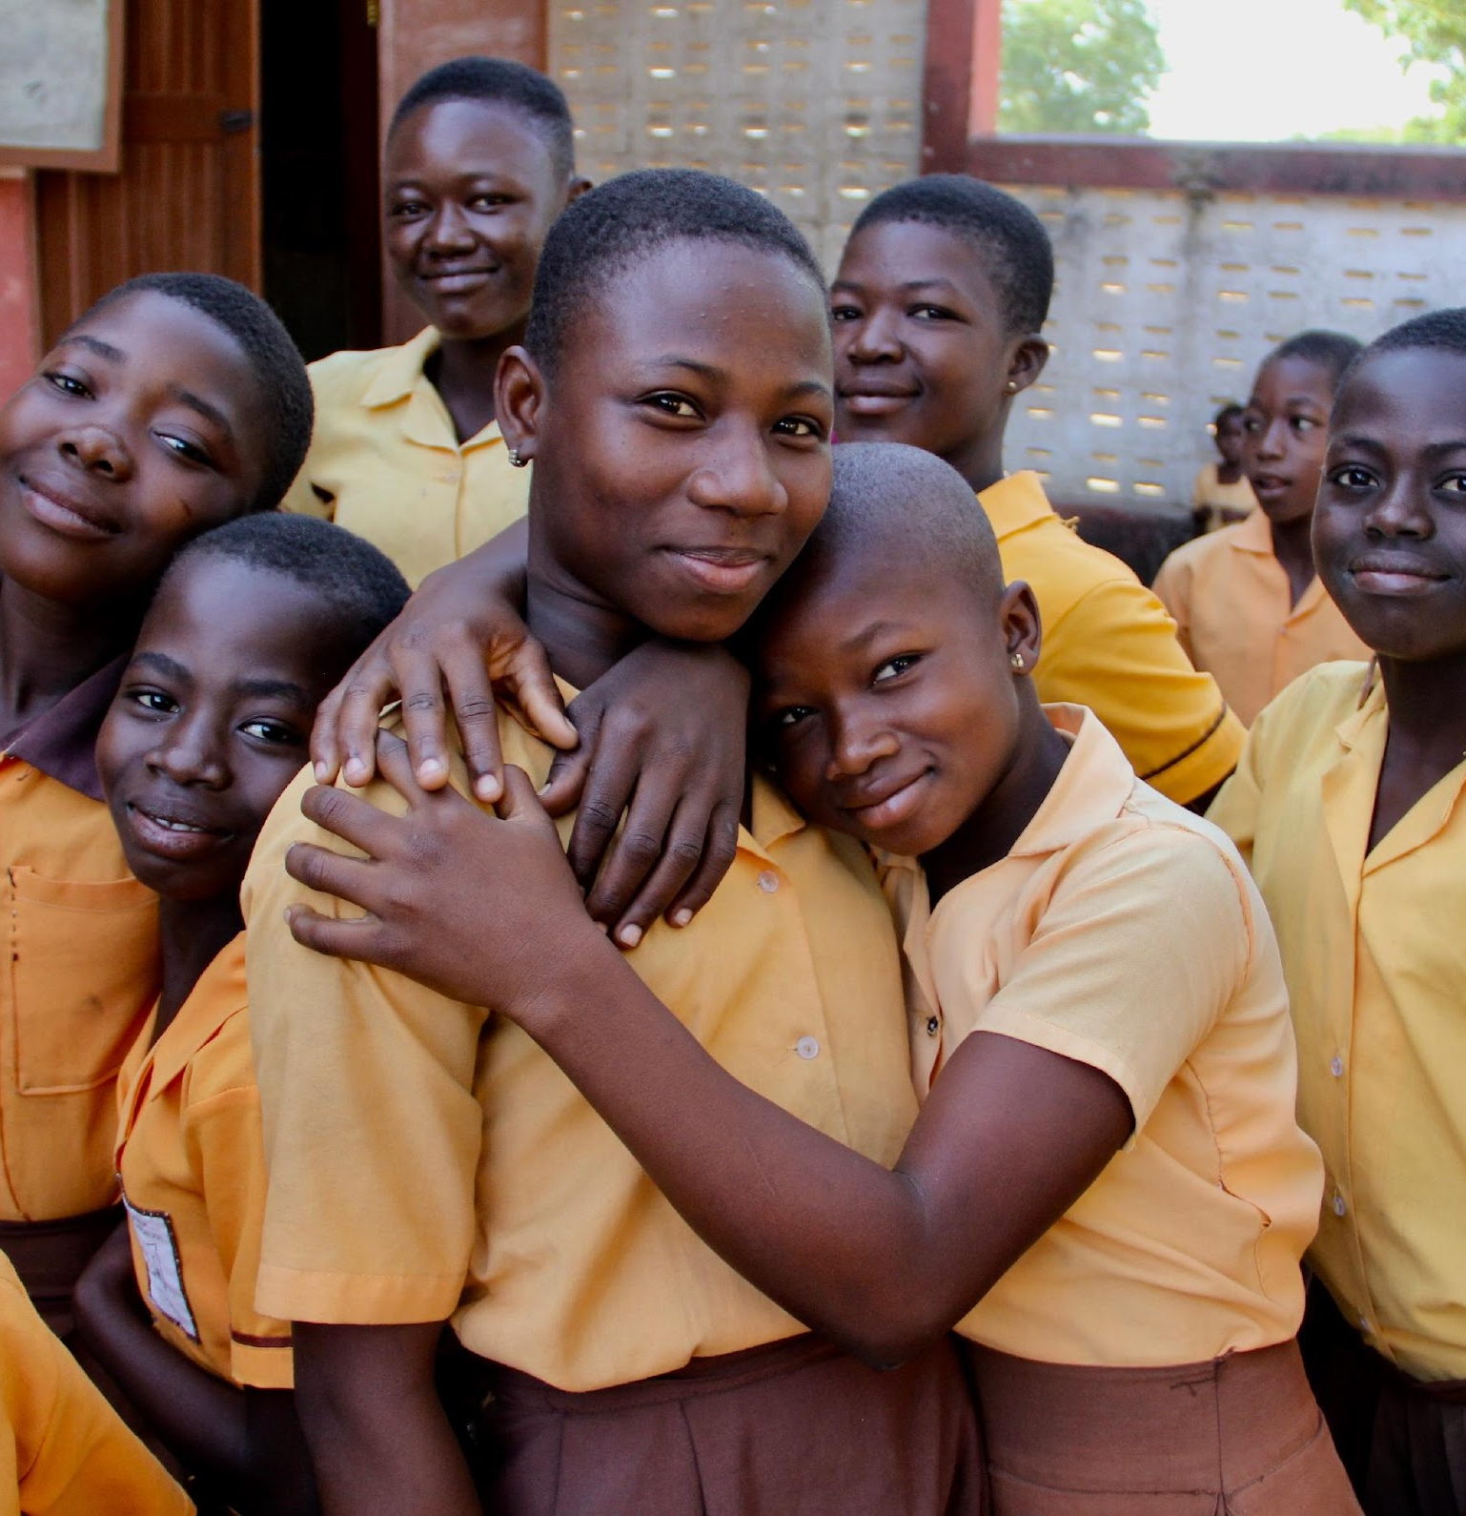
Introductions
Share your name, [location], and one word for what is on your heart today.
Notes:
Leader: Invite each participant to share their name and a word for what is on their heart today.
Zoom group - If the group is 10+ you might invite participants to write this in the chat instead.

Slide 9
Scripture Reading
For it was you who formed my inward parts; you knit me together in my mother’s womb.
I praise you, for I am fearfully and wonderfully made. Wonderful are your works; that I know very well.
Psalm 139:13-14 NRSV
Notes:
Leader: Read the Scripture aloud.

Slide 10
Guided Meditation
Close your eyes or soften your gaze, which ever feels more comfortable for you.
Notes:
Leader: I invite you, now, to check that you are in a comfortable position, loosening and softening your body, as needed.
Zoom group - invite group to turn off cameras, if they wish.
I invite you, now, to check that you are in a comfortable position, loosening and softening your body, as needed. You may close your eyes or soften your gaze, whichever feels more comfortable for you…Beginning to settle yourself [by noticing and putting aside any concerns, unfinished plans, or tensions from this day]...as we take the turn inward, putting ourselves in the presence of God… You may take a few long deep, cleansing breaths, tuning in to the movement of your breath collecting your attention…Breathing in the breath of Spirit, breathing out compassion and care…Breathing in the breath of the Spirit, breathing out welcome and generosity. When you notice thoughts or emotions arising, simply take note and then return your attention, very gently, to your breathing…there is no need to push thoughts or feelings away. Instead, maintain a posture of welcome to your own interior movements.
Continue attending to the breath as you join, in the silence of your heart, in these prayers for the healing of the world:
May we be in loving service to all.
May we be tenacious in humility and deeper understanding.
May we promote the dignity of every human being.
May we understand ourselves to be part of the natural world.
May all children be encouraged to grow and flourish.
May all women be encouraged to grow and flourish.
May we reverence God in all of God’s creation.
May all people find relief from struggle and pain.
May our compassion and hope radiate to all forms of life.
And may our faithful witness be for the healing of the world.
Continue breathing, imagining that with each exhale, you are widening your circle of concern, to include the whole world, from those closest to you to those furthest away.
When you are ready, set an intention for how you would participate in today’s session…and slowly return your awareness to this community gathered.

Slide 11
Learning Together
Notes:
Leader: This session we are exploring how the Episcopal Relief & Development helps communities nurture healthy children under age six and why the first 1,000 days of a child’s life is so important to their overall development.

Slide 12
The Lesson
Protecting Health and Preventing Disease
Empowering Parents
Protecting Parents
Notes:
Leader: Read aloud.

Slide 13
Protecting Health and Preventing Disease
In many countries around the world, pregnant women, mothers and children are most at-risk of contracting deadly and preventable diseases because they lack access to health care.
Notes:
Leader: Read or invite someone to read the description, here.

Slide 14
Protecting Health and Preventing Disease
Episcopal Relief & Development trains local health workers and community volunteers to focus on prenatal and postnatal care, prevention of pneumonia, malaria and diarrhea (e.g. immunizations and nets), mother-to-child transmission and care for families impacted by HIV/AIDS. The programs also provide access to clean water, proper sanitation and hygiene education, and help with early identification and treatment of illnesses.
Notes:
Leader: Read or invite someone to read the description, here.

Slide 15
Empowering Parents
Education about early stimulation and growth and development is critical for children to reach their full potential. Using a holistic and integrated approach, Episcopal Relief & Development focuses on teaching parents and caregivers skills and activities that involve play, nurturing and stimulation through home visits and family support networks. The programs support early care and education and can help children transition to quality preschools and primary school.
Notes:
Leader: Read or invite someone to read the description, here.

Slide 16
Protecting Parents
Social protection lessens the effects of poverty on families, strengthening their ability to care for children and enhance access to basic services. The programs focus on underserved groups and communities by offering counseling and other services to prevent domestic and child abuse, ensure parents have adequate child care and train faith leaders to help put an end to violence and support people in crisis situations.
Notes:
Leader: Read or invite someone to read the description, here.

Slide 17
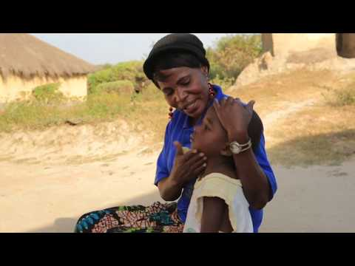
Instructional Video
Notes:
Leader: Let’s take a look at how these priorities play out on the ground and in community.
Note to leader: Video is 2:55 minutes.

Slide 18
Using Mutual Invitation for Sharing
When Mutual Invitation is used, it encourages deep and holy listening to one another, because there is no conversation until everyone has spoken.
Notes:
In order to ensure that everyone who wants to share has the opportunity to speak, we will proceed in the following way:
The leader or a designated person will share first. After that person has spoken, he or she then invites another to share. After the next person has spoken, that person is given the privilege to invite another to share.
If you are not ready to share yet, say “I pass for now” and we will invite you to share later on. If you don’t want to say anything at all, simply say “pass” and proceed to invite another to share. We will do this until everyone has been invited.
The Mutual Invitation process is used in order to insure that everyone who wants to share has the opportunity to speak when the catalyst gives the instruction to do so. As group members become more accustomed to using this tool, they make connections with everyone in the session, because they invite each speaker by name.
When Mutual Invitation is used, it encourages deep and holy listening to one another, because there is no conversation until everyone has spoken once.

Slide 19
Questions for Reflection - Youth
What does this information have to do with me?
How does it challenge or inspire me?
What small step can I take in response?
Notes:
Leader: Offer your response first and then select the next participant to share (i.e., mutual invitation.)

Slide 20
Questions for Reflection - Adult
What moved you in your learning?
Did it stretch or challenge you in some way?
How might your new learning change who you are becoming as a Christian disciple and enrich or equip your witness?
Notes:
Leader: Offer your response first and then select the next participant to share (i.e., mutual invitation.)

Slide 21
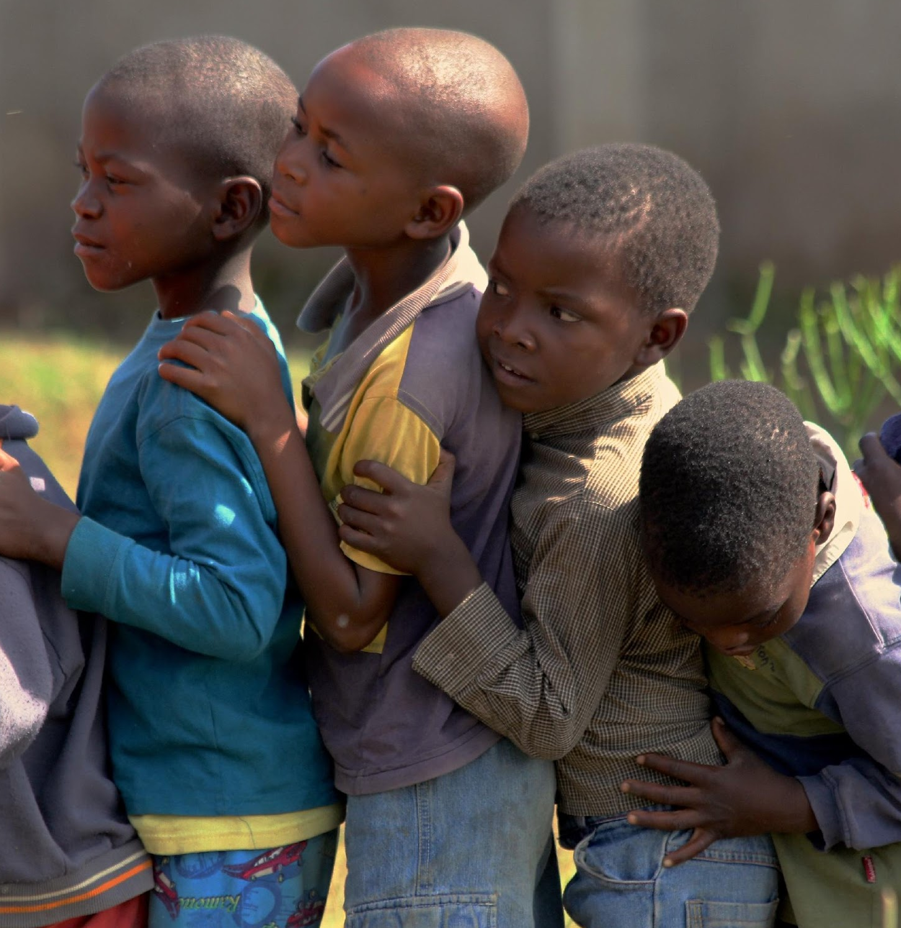
Group Reflection/Brainstorm
What would support your ongoing formation in this area?
Notes:
Leader: Invite the group to brainstorm ideas for ongoing learning and action (popcorn style.)

Slide 22
Pray in this coming week for the people we met today and for one another in this Community of Learning.
Let us pray.
Notes:
Leader: Remind group of their commitment to ongoing prayer (Rule of Life.)

Slide 23
Closing Prayer
Loving God, We thank you for drawing us into the work of justice and flourishing, envisioned by Episcopal Relief & Development.
We ask your blessing upon this learning community, seeking to grow in understanding and commitment.
Guide us, we pray, to walk in your way, so that we may embody
the world that we deeply desire and long for.
Bless our loving actions in our daily lives, our families and partnerships, our communities and connections,
for the Family of God and for all of God’s creation. Amen.
Notes:
Leader: Invite participants to pray together.

Slide 24
At Home
Choose one or more links to explore the topic more deeply:
Ted Talk
Art
Poetry
https://bit.ly/3Pgy5tC
https://bit.ly/3yLiGMb
https://bit.ly/3kx3w8k
Notes:
Leader: Encourage participants to discover additional online resources in their favorite learning modalities.

Slide 25
Notes:
Leader: Thank you for your participation and support of this important work. This curriculum was developed as part of the ONE THOUSAND DAYS OF LOVE campaign.

