Slide 1
Episcopal Relief & Development
Communities of Learning
Contributed by Kathy Bozutti-Jones and Jamie Martin-Currie

Slide 2
Introduction
This four-session curriculum is intended for small group gatherings, online or in person. The objective is to help participants to grow in awareness of, and desire to, serve the populations and priorities aligned with the mission of Episcopal Relief & Development. As a faith formation curriculum, it offers group support and asks participants to be open to where God may be leading, in terms of how to grow in empathy and to respond to your new learnings in daily living. We know that our strengths come from pursuit of the things we are interested in and, so, we trust that our strengths relative to this good work will be revealed in the prayerful learning process.
Notes:
Leader: Read or paraphrase introduction and invite participants to join in the prayer.

Slide 3
Prayer
We ask you, loving God, to open our eyes to what is happening in communities at risk around the world. Guide us as we review the transformative responses of Episcopal Relief & Development.
Open our hearts to see where we might feel led to be of service, too. Amen.
Notes:
Leader: Read or paraphrase introduction and invite participants to join in the prayer.

Slide 4
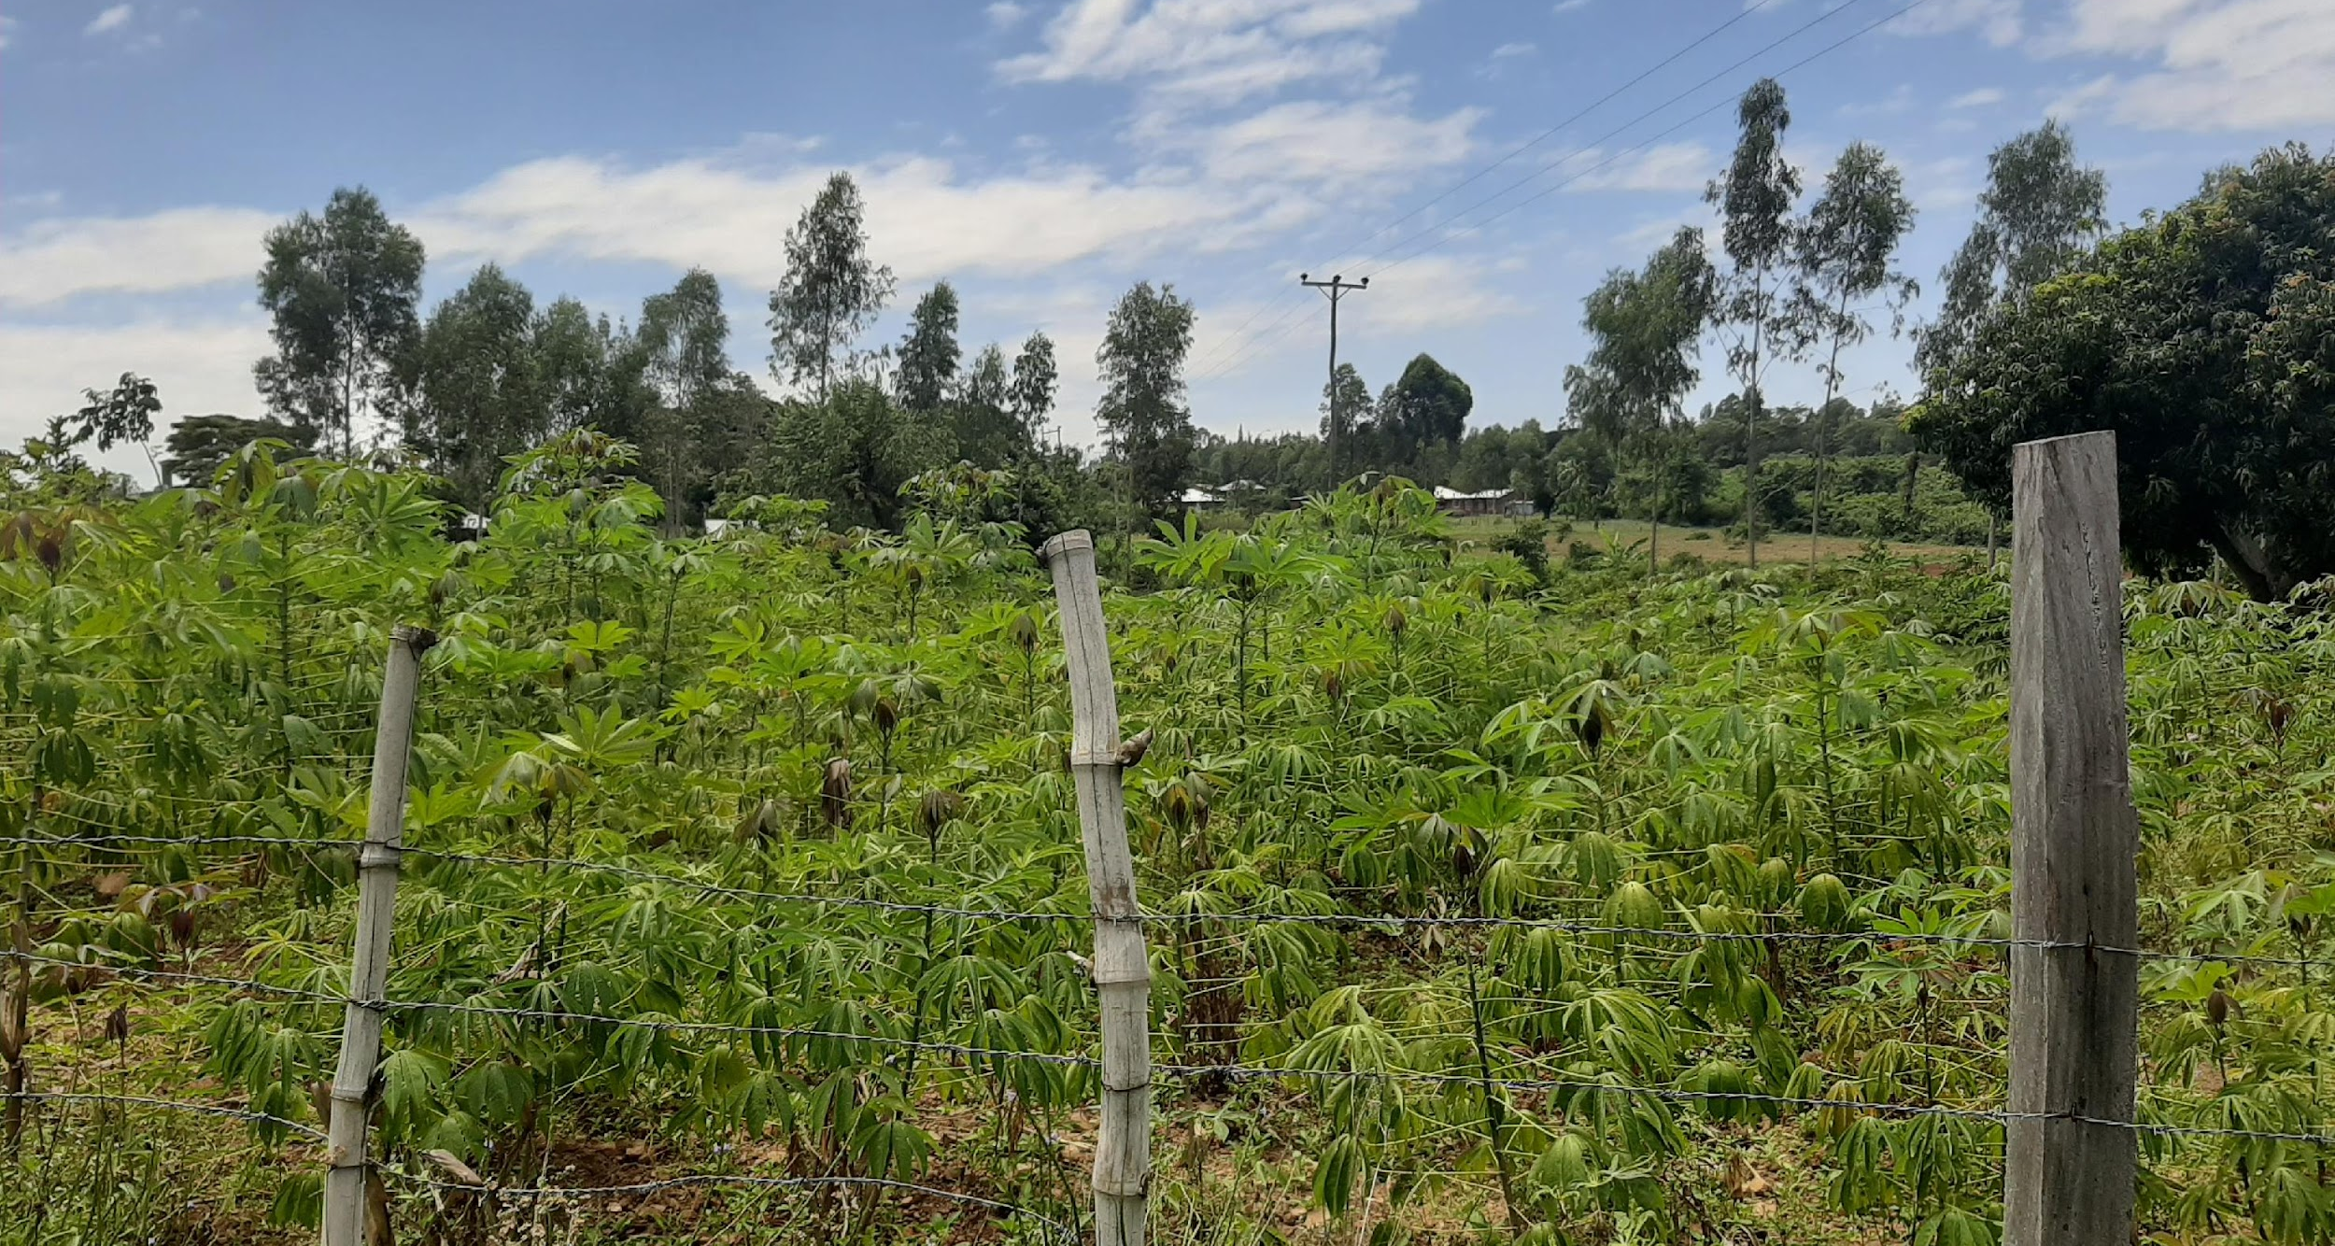
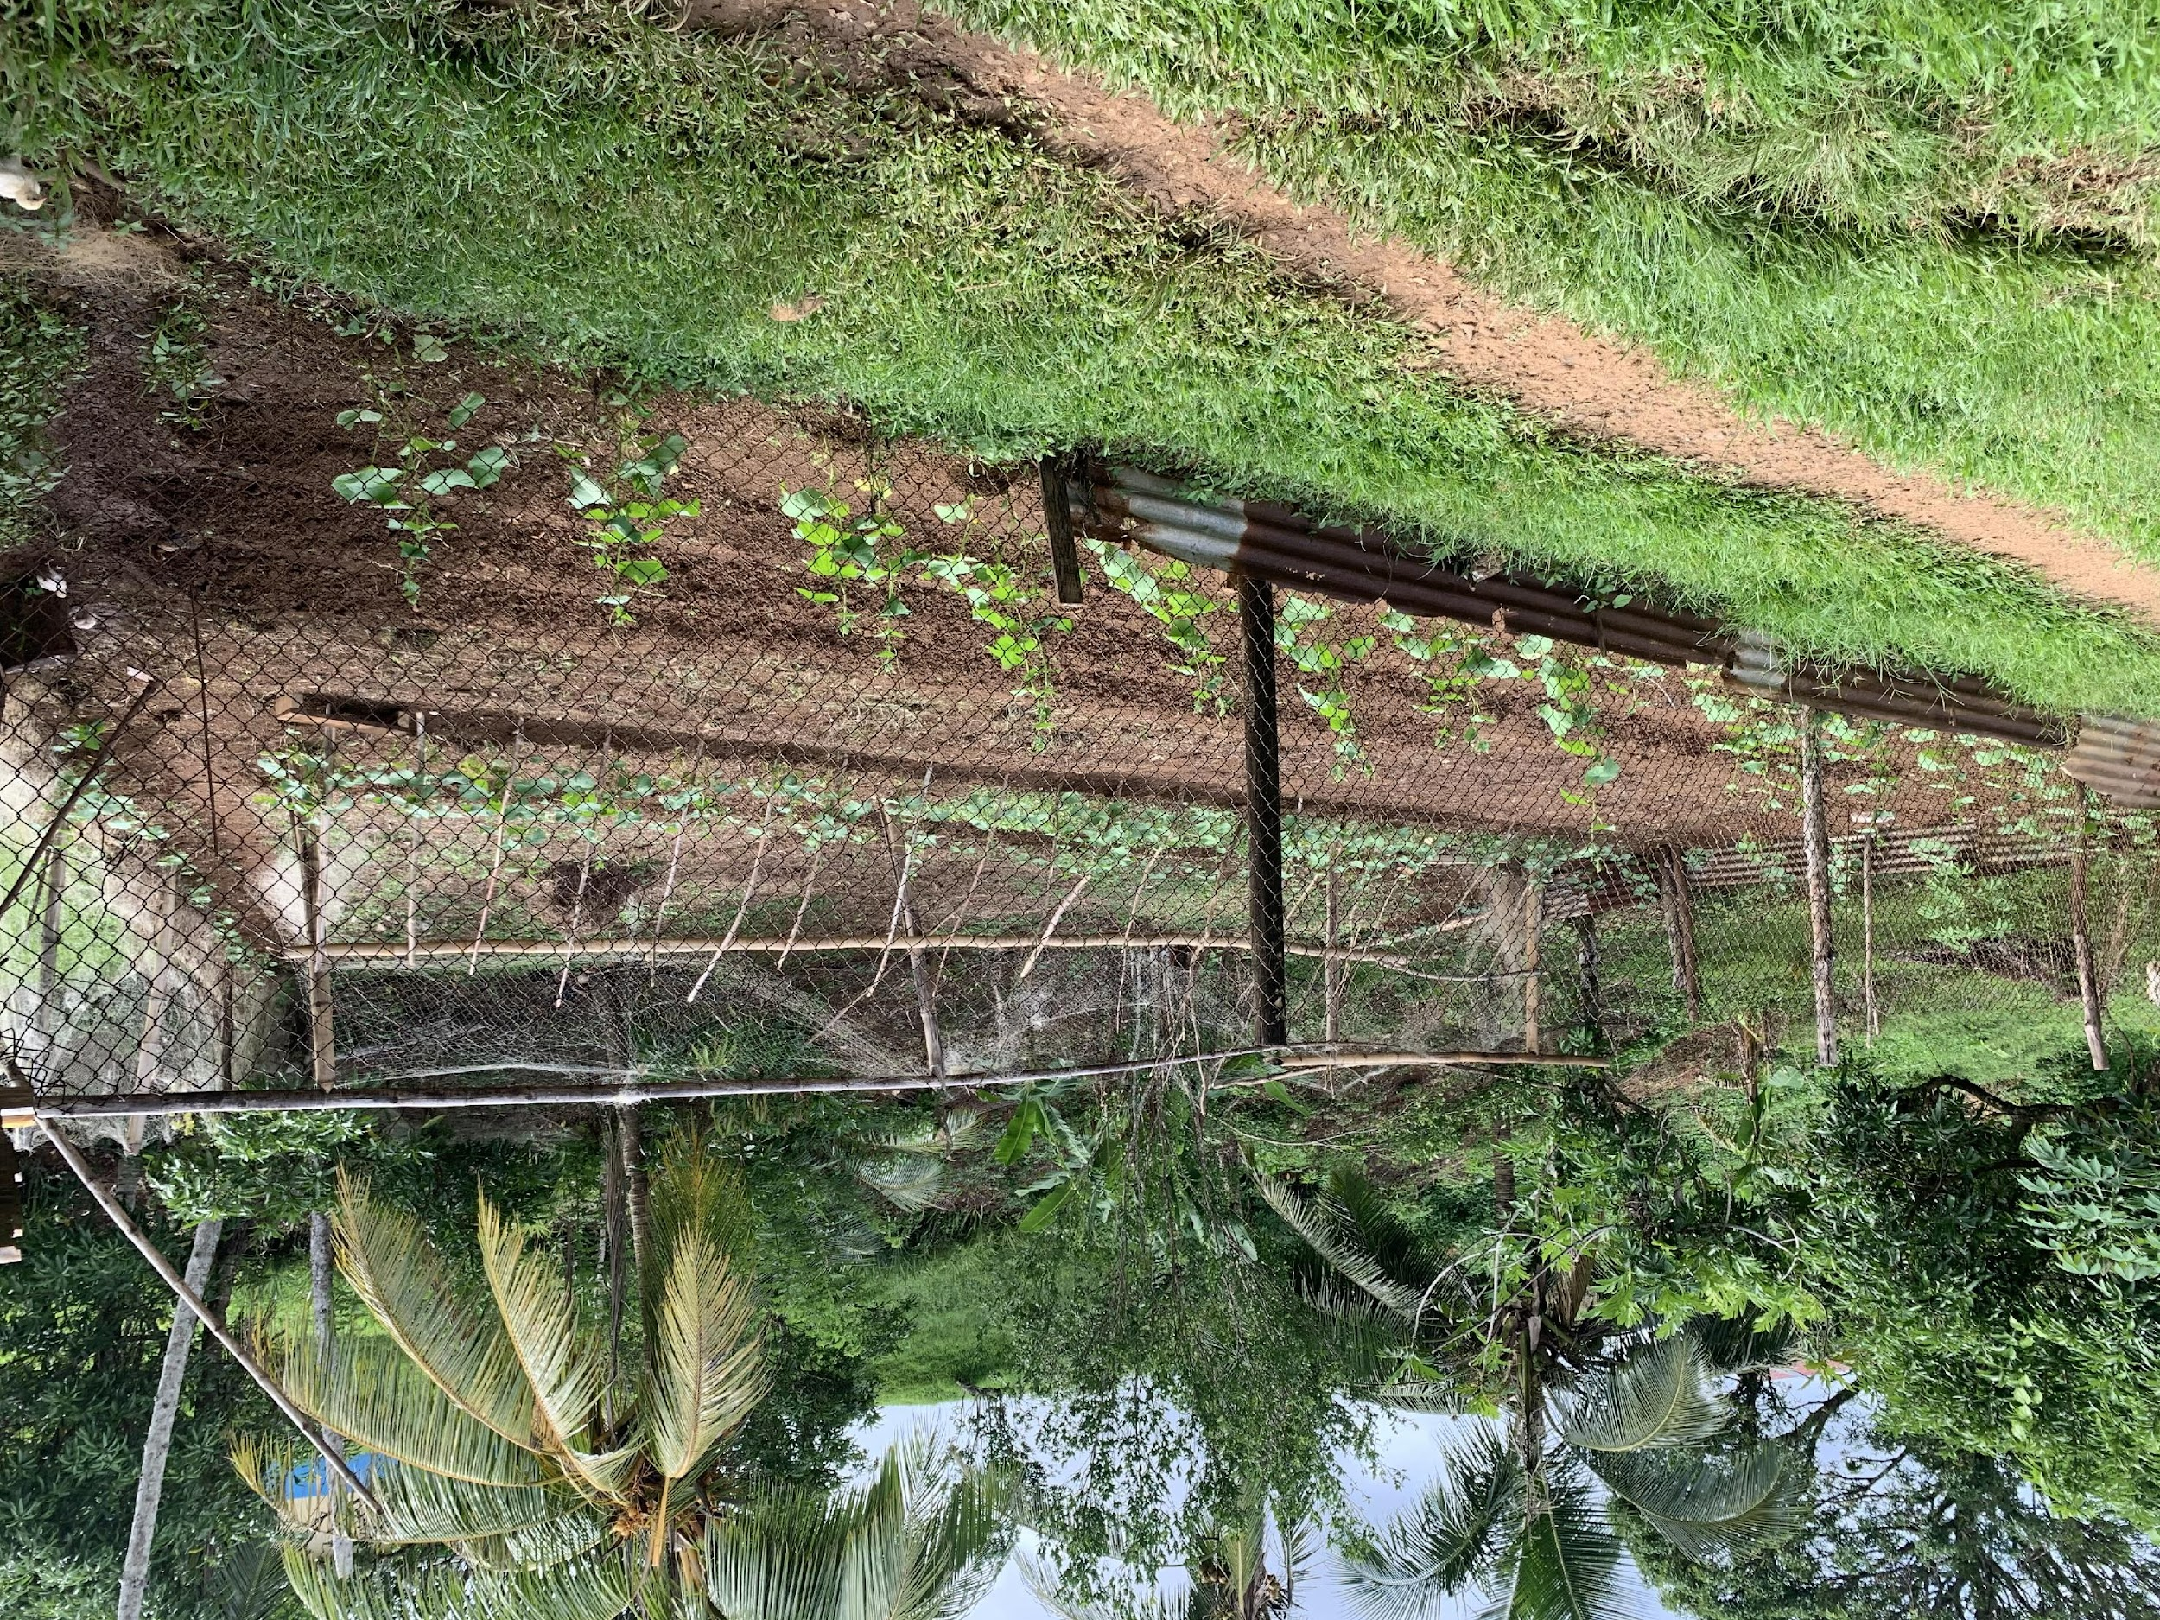
Group Rule of Life
Group Prayer
Guided Meditation
Intercessory Prayer at Home
Notes:
Leader: Explain that there are three ways in which the learning community will commit to a rule of life during the sessions. In other words, the sacred context of each session is understood to include prayer and meditation, together and at home.

Slide 5
Episcopal Relief & Development priorities for Climate
When families and communities work together, they can better prepare for and recover from climate-influenced events.
The number of climate-influenced disasters has doubled in the past 20 years. Floods, hurricanes and other events can devastate communities.
Notes:
Leader: The session begins with a description of our topic. Read aloud or invite a reader.

Slide 6
Opening Prayer – Youth session
We ask your blessing on this learning community, Loving God, that we may be attentive to the movements of your Spirit. Guide us as we grow to understand how we might participate in the global priorities of Episcopal Relief & Development to empower women, nurture children, and meet the challenges of climate change and disaster resilience. We offer to you our open hearts and our desire to promote the dignity of all people. In your name we pray. Amen.
Notes:
Leader: In this Ritual of Dedication, invite online participants to light a candle, take some deep breaths, and pray the opening prayer aloud, together. (“Let us pray…”)

Slide 7
Opening Prayer - Adult session
Loving God, We ask your blessing on this learning community, gathered for mutual formation in the ways of love. Fill us with your Spirit, that we may open our hearts to the needs of women and children at risk, as well as the challenges of climate change and disaster resilience. Guide our efforts, we pray, as we discern what is ours to do in Your plan for human flourishing among all people. May we strive to be your Good News in the world. Amen.
Notes:
Leader: In this Ritual of Dedication, invite online participants to light a candle, take some deep breaths, and pray the opening prayer aloud, together. (“Let us pray…”)

Slide 8
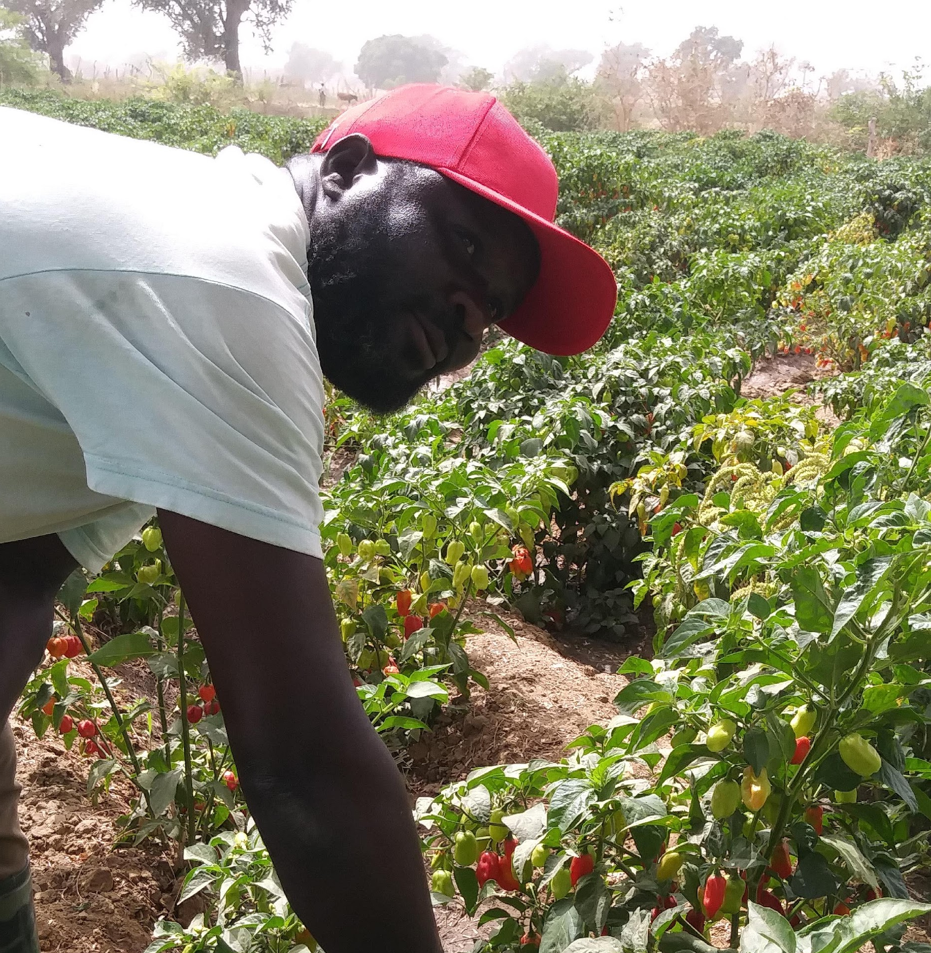
Introductions
Share your name, [location], and one word for what is on your heart today.
Notes:
Leader: Invite each participant to share their name and a word for what is on their heart today.
Zoom group - If the group is 10+ you might invite participants to write this in the chat instead.

Slide 9
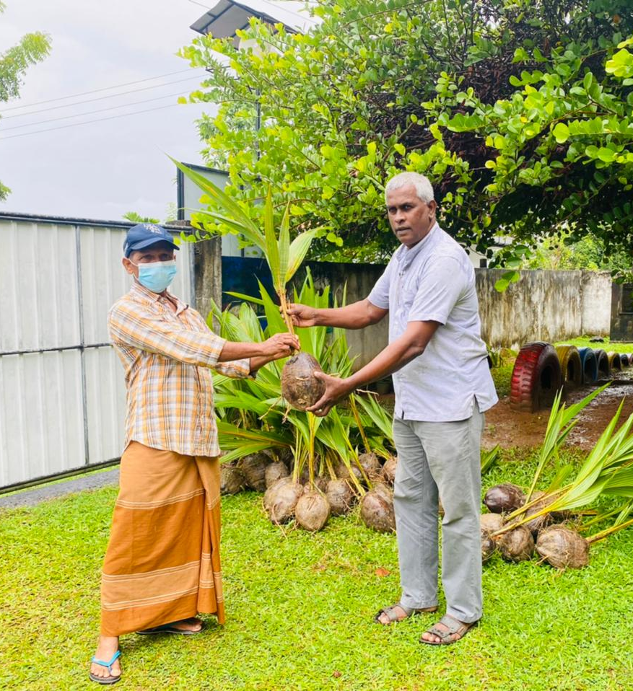
Scripture Reading
Both day and night belong to you; you made the starlight and the sun. You set the boundaries of the earth, and you made both summer and winter.
Psalm 74:16-17 NLV
Notes:
Leader: Read the Scripture aloud.

Slide 10
Guided Meditation
Close your eyes or soften your gaze, which ever feels more comfortable for you.
Notes:
Leader: I invite you, now, to check that you are in a comfortable position, loosening and softening your body, as needed.
Zoom group - invite group to turn off cameras, if they wish
I invite you, now, to check that you are in a comfortable position, loosening and softening your body, as needed. You may close your eyes or soften your gaze, whichever feels more comfortable for you…Beginning to settle yourself [by noticing and putting aside any concerns, unfinished plans, or tensions from this day]...as we take the turn inward, putting ourselves in the presence of God… You may take a few long deep, cleansing breaths, tuning in to the movement of your breath collecting your attention…Breathing in the breath of Spirit, breathing out compassion and care…Breathing in the breath of the Spirit, breathing out welcome and generosity. When you notice thoughts or emotions arising, simply take note and then return your attention, very gently, to your breathing…there is no need to push thoughts or feelings away. Instead, maintain a posture of welcome to your own interior movements.
Continue attending to the breath as you join, in the silence of your heart, in these prayers for the healing of the world:
May we be in loving service to all.
May we be tenacious in humility and deeper understanding.
May we promote the dignity of every human being.
May we understand ourselves to be part of the natural world.
May all children be encouraged to grow and flourish.
May all women be encouraged to grow and flourish.
May we reverence God in all of God’s creation.
May all people find relief from struggle and pain.
May our compassion and hope radiate to all forms of life.
And may our faithful witness be for the healing of the world.
Continue breathing, imagining that with each exhale, you are widening your circle of concern, to include the whole world, from those closest to you to those furthest away.
When you are ready, set an intention for how you would participate in today’s session…and slowly return your awareness to this community gathered.

Slide 11
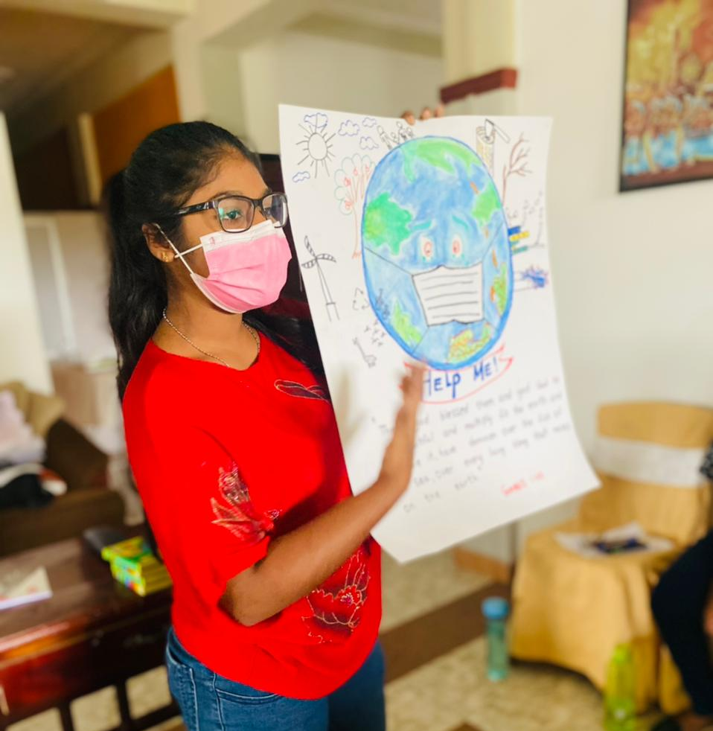
Learning Together
Notes:
This session we are exploring how Episcopal Relief & Development’s work with local Church and ecumenical partners is designed to help communities prepare for disasters and recover as quickly as possible. We focus on three key areas to address issues related to climate:

Slide 12
The Lesson
Improving Food and Nutrition
Creating Economic Stability
Providing access to Clean Water, Hygiene and Sanitation
Notes:
Leader: Read aloud.

Slide 13
Improving Food and Nutrition
Our work with communities supports nutrition counseling during and after pregnancy, promotes breastfeeding and effective feeding and care practices for families and ensures families have enhanced access to nutritious foods. Episcopal Relief & Development programs also monitor the growth and development of children over the critical early years and link with health systems as needed for maximum care.
Notes:
Leader: Read or invite someone to read the description, here.

Slide 14
Creating Economic Stability
A family’s access to financial resources and education has a direct impact on a child’s development and their performance in school. Episcopal Relief & Development programs create economic opportunities and strengthens communities to help parents and caregivers earn an income.
Notes:
Leader: Read or invite someone to read the description, here.

Slide 15
Creating Economic Stability
This work includes supporting Savings with Education (SwE) groups, providing financial and business training, providing loans to individuals and groups for small businesses and developing micro-insurance products, village banks and cooperatives for people without access to traditional financial markets and institutions.
Notes:
Leader: Read or invite someone to read the description, here.

Slide 16
Providing Access to Clean Water, Hygiene & Sanitation
Clean water, proper sanitation and hygiene education are critically important to prevent the spread of disease, as well as protect communities when climate-influenced disasters occur. The work to create clean and safe water for drinking includes building wells and piping systems to prevent waterborne illnesses and installing water stations and systems like rainwater catchment tanks.
Notes:
Leader: Read or invite someone to read the description, here.

Slide 17
Providing Access to Clean Water, Hygiene & Sanitation
Sanitation programs include building or improving sanitary toilets, educating people on the proper hand-washing techniques, installing of hand-washing stations next to latrines and protecting land and water sources. They also empower local community health workers to train residents in safe garbage and waste disposal.
Notes:
Leader: Read or invite someone to read the description, here.

Slide 18
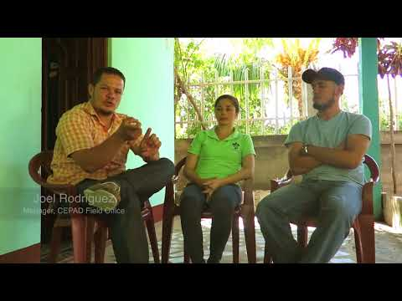
Instructional Video
Notes:
Leader: Let’s take a look at how these priorities play out on the ground and in community.
Note to leader: Video is 4:40 minutes.

Slide 19
Using Mutual Invitation for Sharing
When Mutual Invitation is used, it encourages deep and holy listening to one another, because there are no interruptions allowed until everyone has spoken.
Notes:
In order to ensure that everyone who wants to share has the opportunity to speak, we will proceed in the following way:
The leader or a designated person will share first. After that person has spoken, he or she then invites another to share. After the next person has spoken, that person is given the privilege to invite another to share.
If you are not ready to share yet, say “I pass for now” and we will invite you to share later on. If you don’t want to say anything at all, simply say “pass” and proceed to invite another to share. We will do this until everyone has been invited.
The Mutual Invitation process is used in order to insure that everyone who wants to share has the opportunity to speak when the catalyst gives the instruction to do so. As group members become more accustomed to using this tool, they make connections with everyone in the session, because they invite each speaker by name.
When Mutual Invitation is used, it encourages deep and holy listening to one another, because there is no conversation until everyone has spoken once.

Slide 20
Questions for Reflection – Youth session
What does this information have to do with me?
How does it challenge or inspire me?
What small step can I take in response?
Notes:
Leader: Offer your response first and then select the next participant to share (i.e., mutual invitation.)

Slide 21
Questions for Reflection – Adult session
What moved you in your learning?
Did it stretch or challenge you in some way?
How might your new learning change who you are becoming as a Christian disciple and enrich or equip your witness?
Notes:
Leader: Offer your response first and then select the next participant to share (i.e., mutual invitation.)

Slide 22
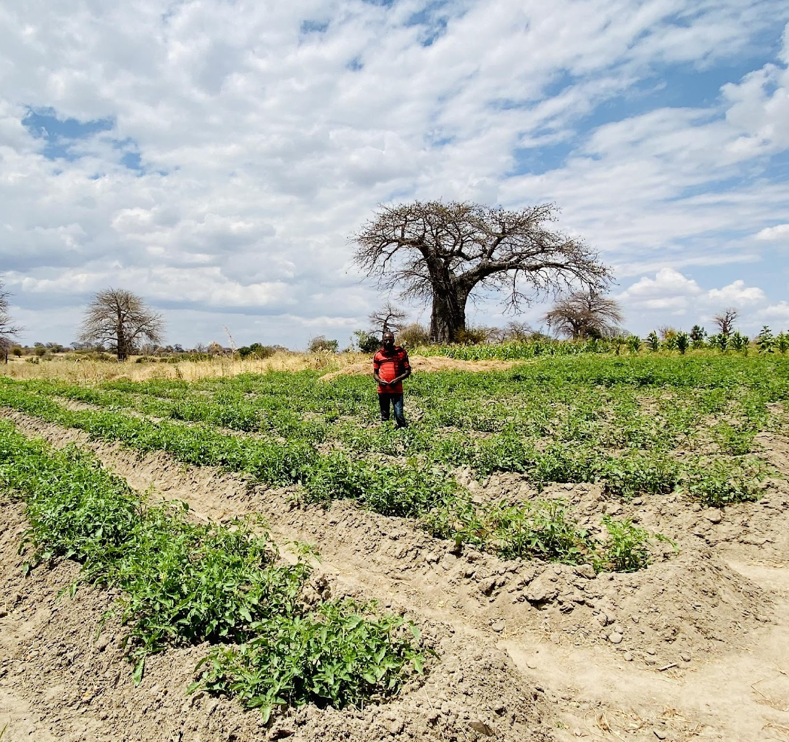
Group Reflection/Brainstorm
What would support your ongoing formation in this area?
Notes:
Leader: Invite the group to brainstorm ideas for ongoing learning and action (popcorn style.)

Slide 23
Pray in this coming week for the people we met today and for one another in this Community of Learning.
Let us pray.
Notes:
Leader: Remind group of their commitment to ongoing prayer (Rule of Life.)

Slide 24
Closing Prayer
Loving God, We thank you for drawing us into the work of justice and flourishing, envisioned by Episcopal Relief & Development.
We ask your blessing upon this learning community, seeking to grow in understanding and commitment.
Guide us, we pray, to walk in your way, so that we may embody the world that we deeply desire and long for.
Bless our loving actions in our daily lives, our families and partnerships, our communities and connections, for the Family of God and for all of God’s creation. Amen.
Notes:
Leader: Invite participants to pray together.

Slide 25
At Home
Choose one or more links to explore the topic more deeply:
Ted Talk
Music
Art
https://bit.ly/3N41ghB
https://bit.ly/3wtYrRs
https://bit.ly/39hgVeY
Notes:
Leader: Encourage participants to discover additional online resources in their favorite learning modalities.

Slide 26
Notes:
Leader: Thank you for your participation and support of this important work. This curriculum was developed as part of the ONE THOUSAND DAYS OF LOVE campaign.

