Slide 1
Episcopal Relief & Development
Communities of Learning
Contributed by Kathy Bozutti-Jones and Jamie Martin-Currie

Slide 2
Introduction
This four-session curriculum is intended for small group gatherings, online or in person. The objective is to help participants to grow in awareness of, and desire to, serve the populations and priorities aligned with the mission of Episcopal Relief & Development. As a faith formation curriculum, it offers group support and asks participants to be open to where God may be leading, in terms of how to grow in empathy and to respond to your new learnings in daily living. We know that our strengths come from pursuit of the things we are interested in and, so, we trust that our strengths relative to this good work will be revealed in the prayerful learning process.
Notes:
Leader: Read or paraphrase introduction and invite participants to join in the prayer.

Slide 3
Prayer
We ask you, loving God, to open our eyes to what is happening in communities at risk around the world. Guide us as we review the transformative responses of Episcopal Relief & Development.
Open our hearts to see where we might feel led to be of service, too.
Amen.
Notes:
Leader: Read or paraphrase introduction and invite participants to join in the prayer.

Slide 4
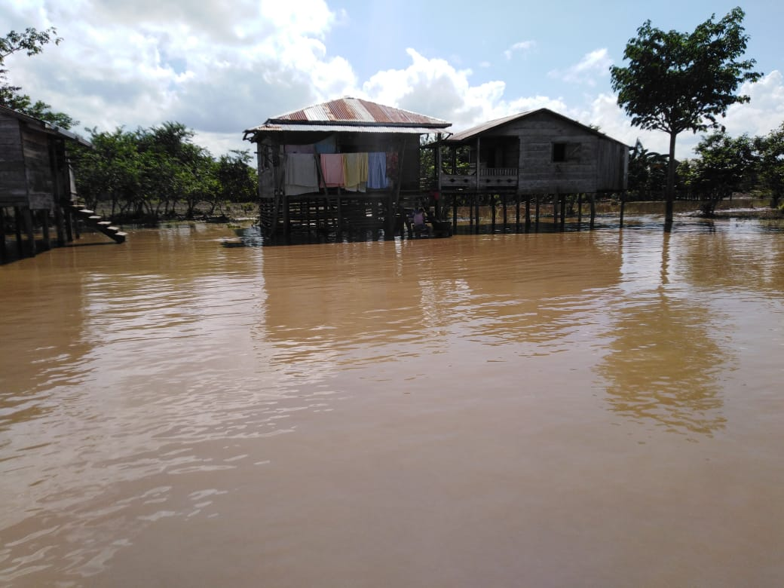
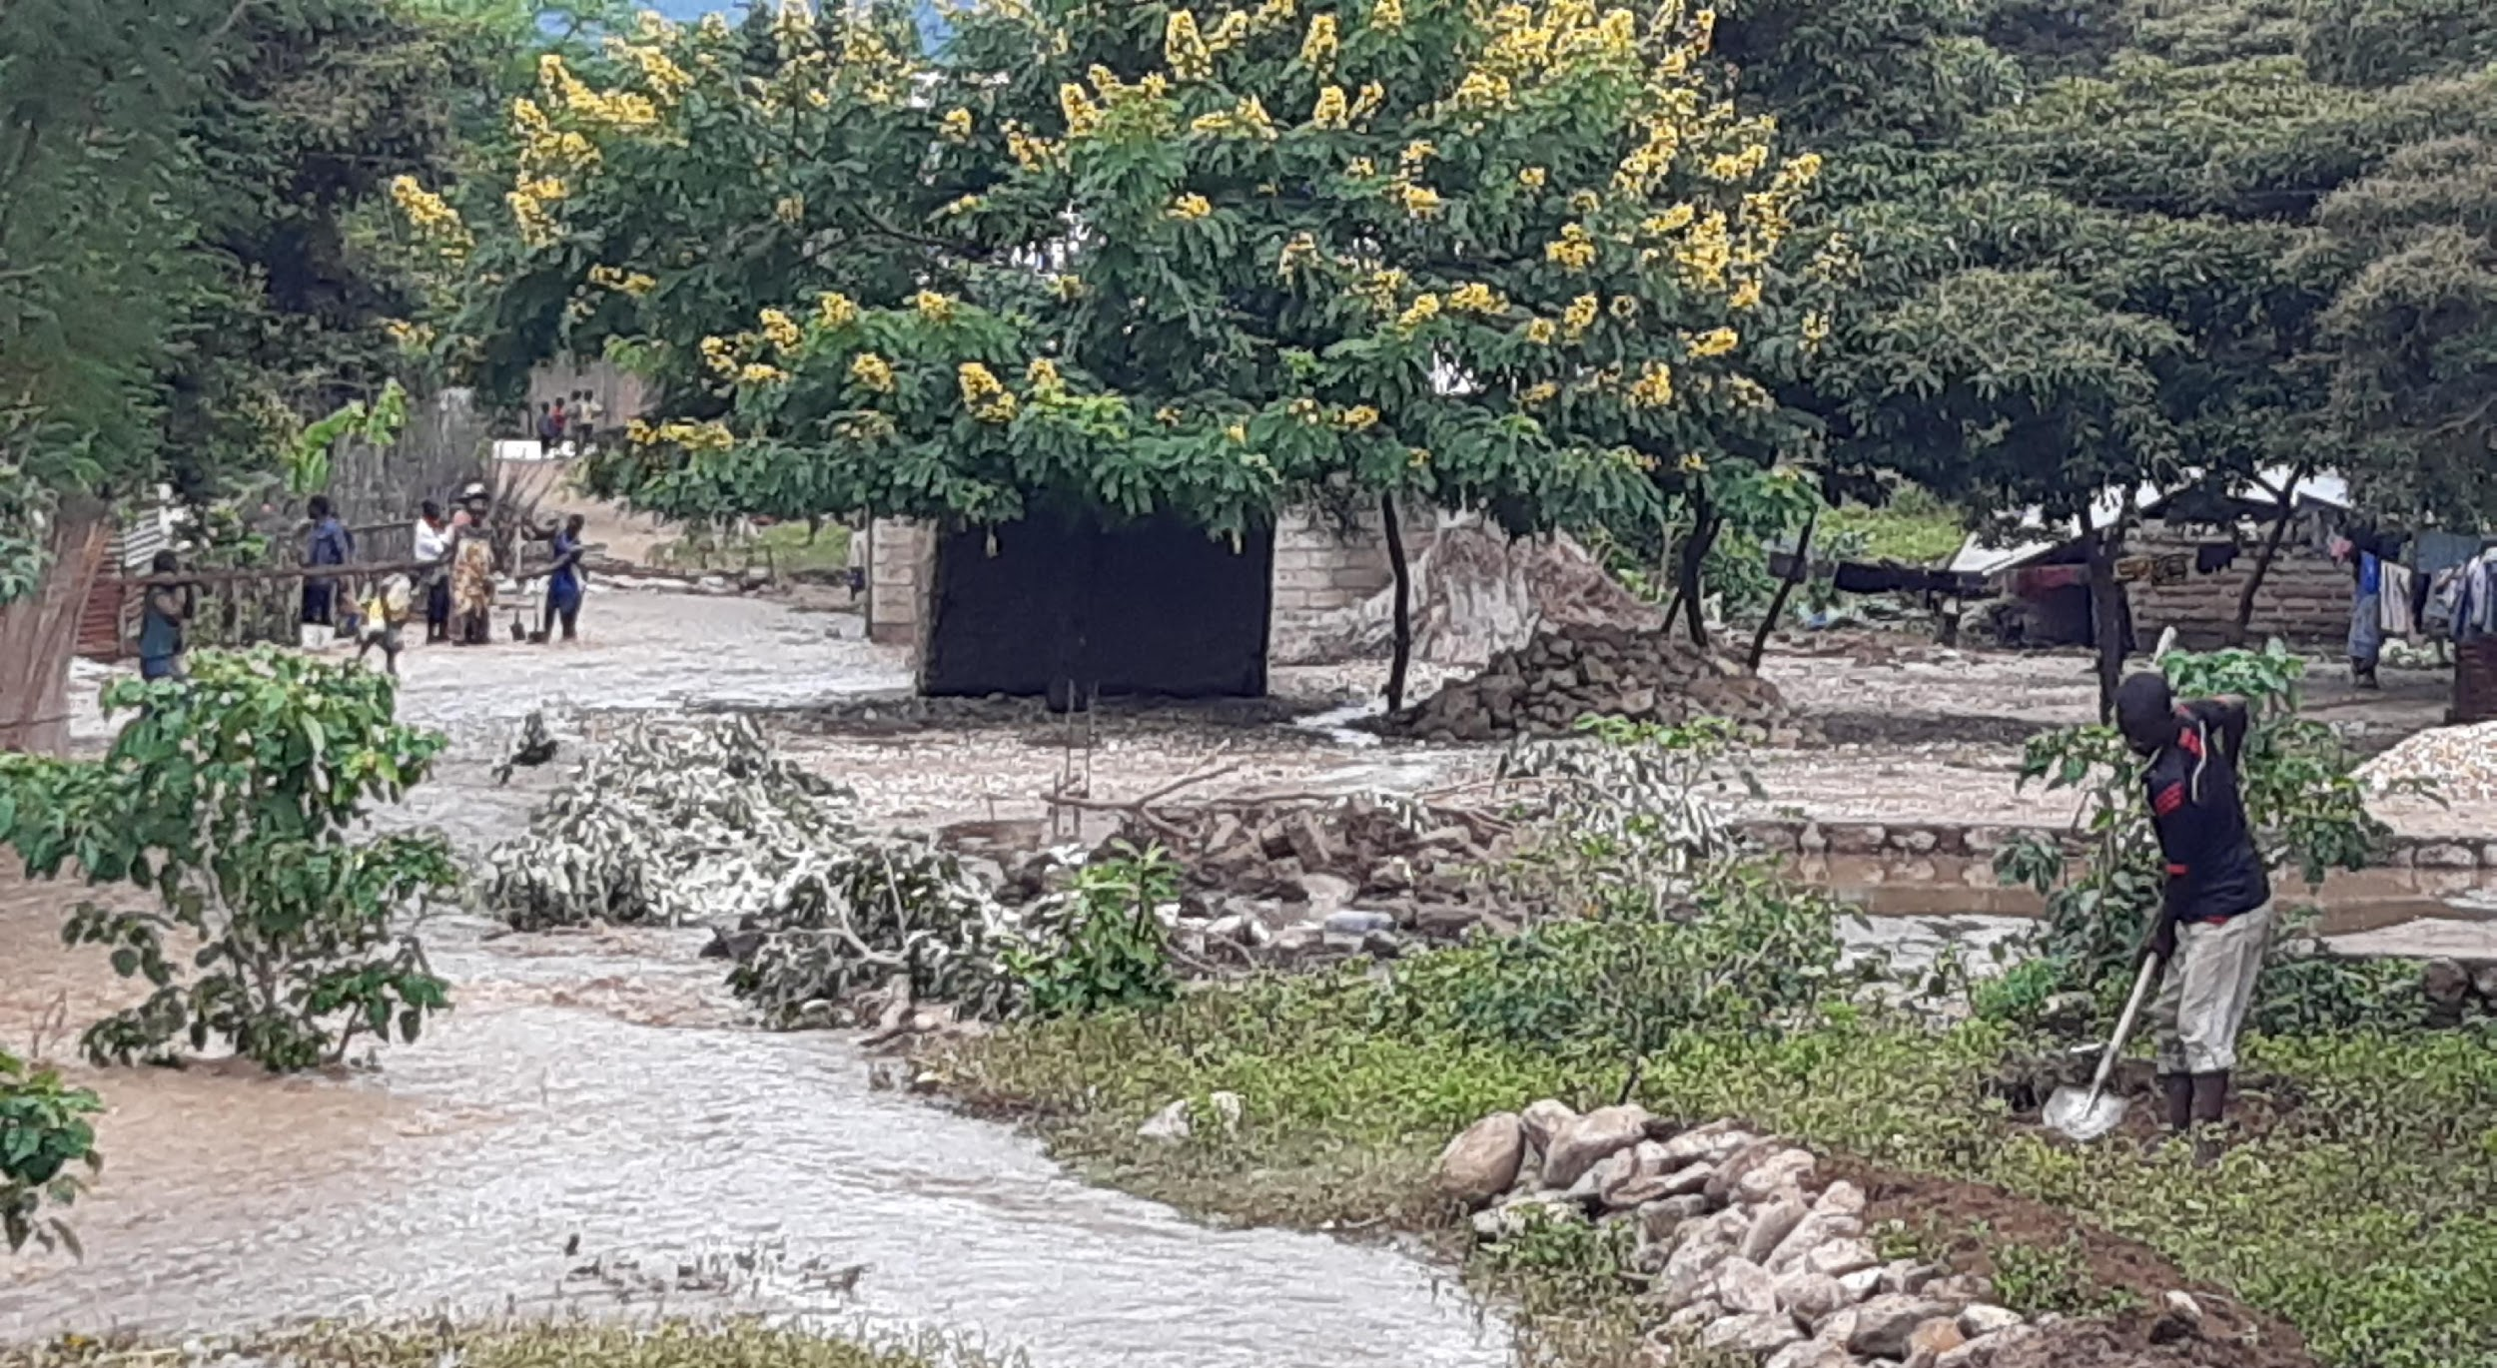
Group Rule of Life
Group Prayer
Guided Meditation
Intercessory Prayer at Home
Notes:
Leader: Explain that there are three ways in which the learning community will commit to a rule of life during the sessions. In other words, the sacred context of each session is understood to include prayer and meditation, together and at home.

Slide 5
We will explore Episcopal Relief & Development’s work in Disaster Response & Resilience and how we can apply this in our daily lives.
Disaster response & resilience includes preparedness, mitigation and response. Episcopal Relief & Development works with local Anglican and Episcopal Church partners to build resilient communities that are better able to respond when disasters occur.
Notes:
Leader: The session begins with a description of our topic. Read aloud or invite a reader.

Slide 6
Opening Prayer - Youth session
We ask your blessing on this learning community, Loving God, that we may be attentive to the movements of your Spirit. Guide us as we grow to understand how we might participate in the global priorities of Episcopal Relief & Development to empower women, nurture children, and meet the challenges of climate change and disaster resilience. We offer to you our open hearts and our desire to promote the dignity of all people. In your name we pray. Amen.
Notes:
Leader: In this Ritual of Dedication, invite online participants to light a candle, take some deep breaths, and pray the opening prayer aloud, together.
Let us pray…

Slide 7
Opening Prayer - Adult session
Loving God, We ask your blessing on this learning community, gathered for mutual formation in the ways of love. Fill us with your Spirit, that we may open our hearts to the needs of women and children at risk, as well as the challenges of climate change and disaster resilience. Guide our efforts, we pray, as we discern what is ours to do in Your plan for human flourishing among all people. May we strive to be your Good News in the world. Amen.
Notes:
Leader: In this Ritual of Dedication, invite online participants to light a candle, take some deep breaths, and pray the opening prayer aloud, together.
Let us pray…

Slide 8
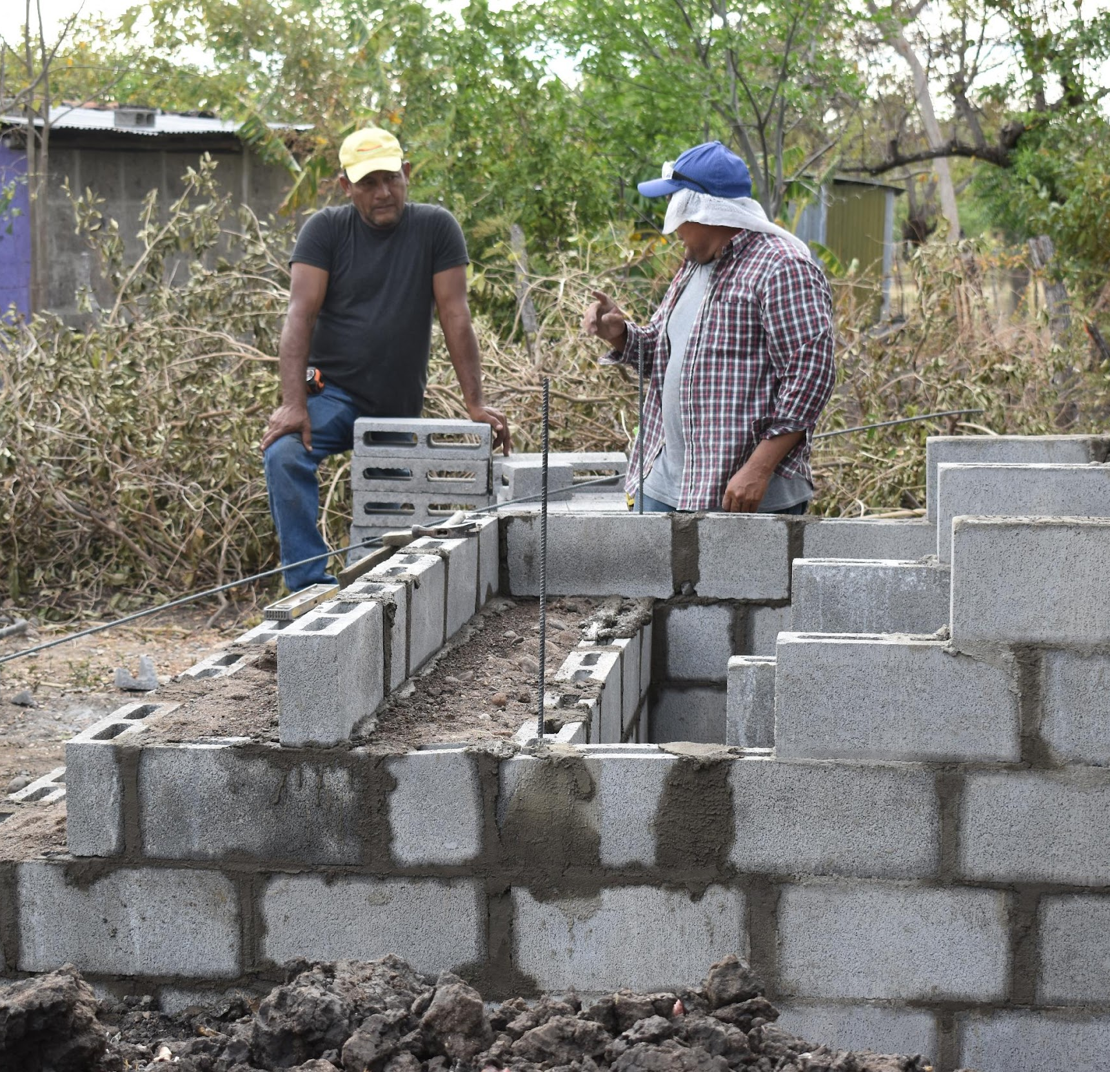
Introductions
Share your name, [location], and one word for what is on your heart today.
Notes:
Leader: Invite each participant to share their name and a word for what is on their heart today.
Zoom group - If the group is 10+ you might invite participants to write this in the chat instead.

Slide 9
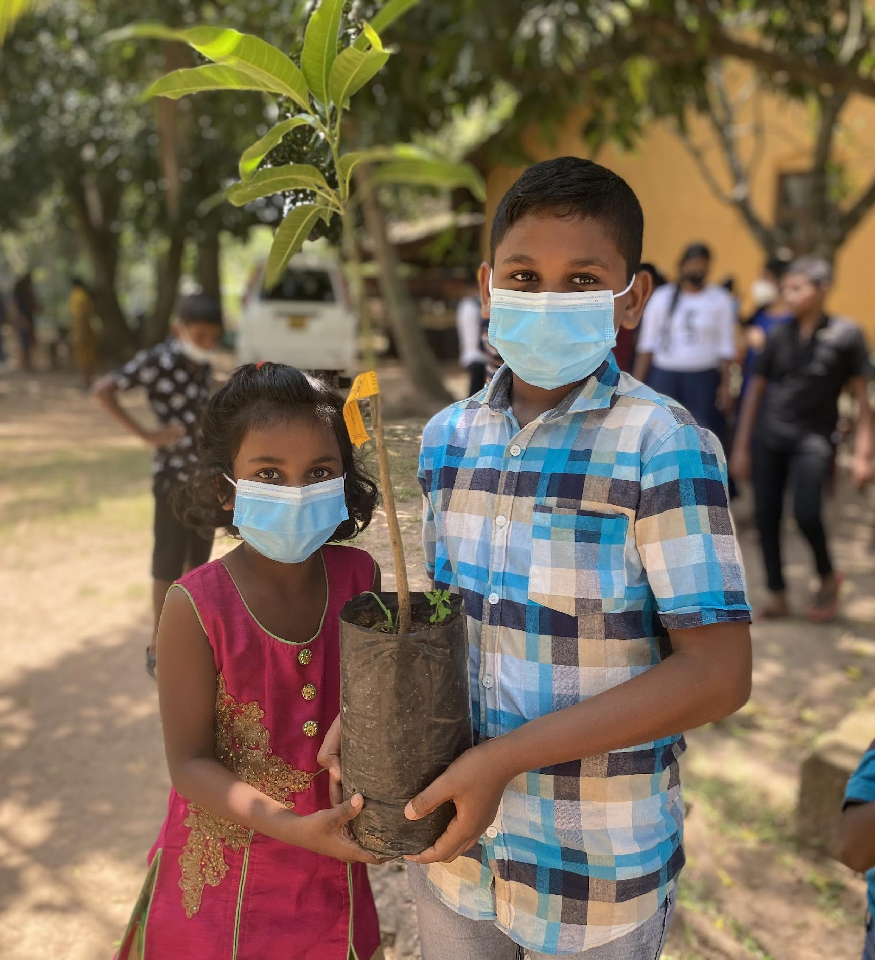
Scripture Reading
The Lord upholds all who are falling, and raises up all who are bowed down.
Psalm 145:14 NRSV
Notes:
Leader: Read the Scripture aloud.

Slide 10
Guided Meditation
Close your eyes or soften your gaze, which ever feels more comfortable for you.
Notes:
Leader: I invite you, now, to check that you are in a comfortable position, loosening and softening your body, as needed.
Zoom group - invite group to turn off cameras, if they wish
I invite you, now, to check that you are in a comfortable position, loosening and softening your body, as needed. You may close your eyes or soften your gaze, whichever feels more comfortable for you…Beginning to settle yourself [by noticing and putting aside any concerns, unfinished plans, or tensions from this day]...as we take the turn inward, putting ourselves in the presence of God… You may take a few long deep, cleansing breaths, tuning in to the movement of your breath collecting your attention…Breathing in the breath of Spirit, breathing out compassion and care…Breathing in the breath of the Spirit, breathing out welcome and generosity. When you notice thoughts or emotions arising, simply take note and then return your attention, very gently, to your breathing…there is no need to push thoughts or feelings away. Instead, maintain a posture of welcome to your own interior movements.
Continue attending to the breath as you join, in the silence of your heart, in these prayers for the healing of the world:
May we be in loving service to all.
May we be tenacious in humility and deeper understanding.
May we promote the dignity of every human being.
May we understand ourselves to be part of the natural world.
May all children be encouraged to grow and flourish.
May all women be encouraged to grow and flourish.
May we reverence God in all of God’s creation.
May all people find relief from struggle and pain.
May our compassion and hope radiate to all forms of life.
And may our faithful witness be for the healing of the world.
Continue breathing, imagining that with each exhale, you are widening your circle of concern, to include the whole world, from those closest to you to those furthest away.
When you are ready, set an intention for how you would participate in today’s session…and slowly return your awareness to this community gathered.

Slide 11
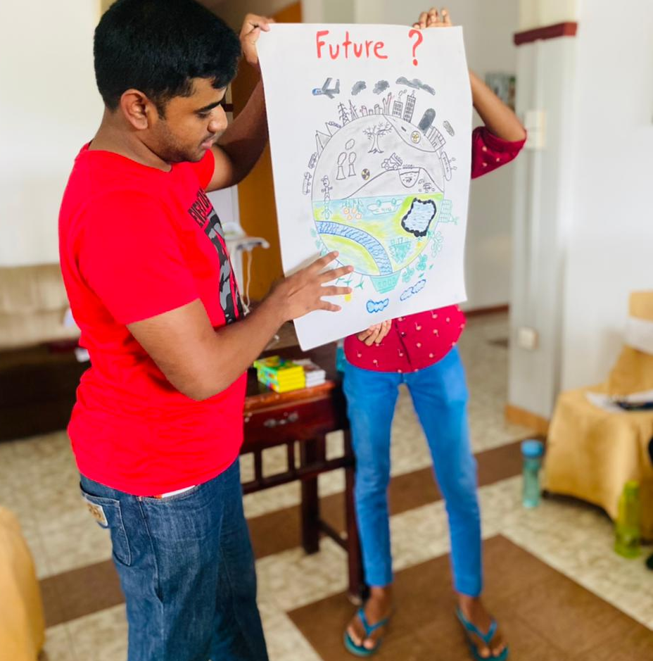
Learning Together
Notes:
This session we are exploring how Episcopal Relief & Developments work with local Church and ecumenical partners is designed to help communities prepare for disasters and recover as quickly as possible. We focus on two key areas to address issues related to disaster and resilience.

Slide 12
The Lesson
Reducing the Impact of Disasters
Managing Environmental Preparedness
Notes:
Leader: Read aloud.

Slide 13
Reducing the Impact of Disasters
If communities are prepared and ready to adapt when a climate-influenced disaster occurs, they are much more likely to successfully recover. Our work is designed to help communities anticipate, resist, cope with and recover from climate-influenced hazards and events. In all of our programs, we provide critical assistance to help alleviate suffering, restore dignity, build resilience and jump-start economic recovery.
Notes:
Leader: Read or invite someone to read the description, here.

Slide 14
Reducing the Impact of Disasters
Using a wide network of Episcopal dioceses and other church institutions in the US, we offer resources and training to help people prepare for disasters and provide emergency support so vulnerable communities can make a full and sustained recovery. Globally, our disaster programs help people prepare for crises through the coordination and training of local partners and communities so they are better able to serve and care for at-risk populations.
Notes:
Leader: Read or invite someone to read the description, here.

Slide 15
Managing Environmental Preparedness
The best defense against climate-influenced disasters is to be as prepared as possible before disaster strikes. Our staff and partners are committed to properly safeguarding land and other natural resources to protect the environment, lessen the impact of disasters and minimize suffering and damage that often hinder the recovery process.
Notes:
Leader: Read or invite someone to read the description, here.

Slide 16
Managing Environmental Preparedness
Working in diverse local contexts and disaster situations, our programs promote tree planting and support other sustainable practices such as preventing deforestation and soil erosion. We also train communities to understand and identify where they are most vulnerable and how to protect themselves in advance of disasters. Activities may include providing tools and resources, installing early warning systems or protecting homes in flood-prone areas.
Notes:
Leader: Read or invite someone to read the description, here.

Slide 17
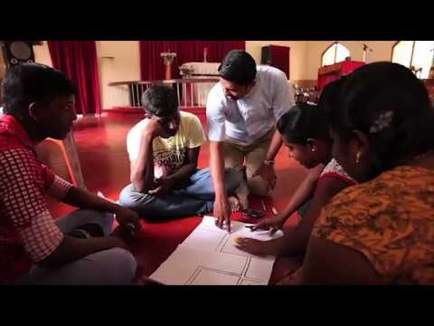
Instructional Video
Notes:
Leader: Let’s take a look at how these priorities play out on the ground and in community.
Note to leader: Video is 5:10 minutes.

Slide 18
Using Mutual Invitation for Sharing
When Mutual Invitation is used, it encourages deep and holy listening to one another, because there are no interruptions or refutations allowed until everyone has spoken.
Notes:
In order to ensure that everyone who wants to share has the opportunity to speak, we will proceed in the following way:
The leader or a designated person will share first. After that person has spoken, he or she then invites another to share. After the next person has spoken, that person is given the privilege to invite another to share.
If you are not ready to share yet, say “I pass for now” and we will invite you to share later on. If you don’t want to say anything at all, simply say “pass” and proceed to invite another to share. We will do this until everyone has been invited.
The Mutual Invitation process is used in order to insure that everyone who wants to share has the opportunity to speak when the catalyst gives the instruction to do so. As group members become more accustomed to using this tool, they make connections with everyone in the session, because they invite each speaker by name.
When Mutual Invitation is used, it encourages deep and holy listening to one another, because there is no conversation until everyone has spoken once.

Slide 19
Questions for Reflection - Youth session
What does this information have to do with me?
How does it challenge or inspire me?
What small step can I take in response?
Notes:
Leader: Offer your response first and then select the next participant to share (i.e., mutual invitation.)

Slide 20
Questions for Reflection - Adult session
What moved you in your learning?
Did it stretch or challenge you in some way?
How might your new learning change who you are becoming as a Christian disciple and enrich or equip your witness?
Notes:
Leader: Offer your response first and then select the next participant to share (i.e., mutual invitation.)

Slide 21
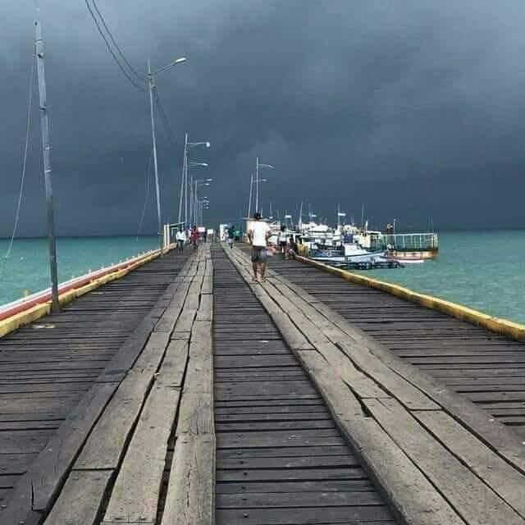
Group Reflection/Brainstorm
What would support your ongoing formation in this area?
Notes:
Leader: Invite the group to brainstorm ideas for ongoing learning and action (popcorn style.)

Slide 22
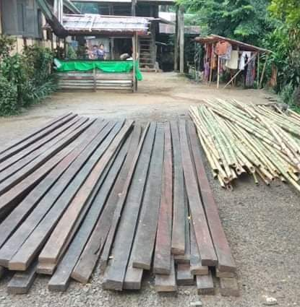
Pray in this coming week for the people we met today and for one another in this Community of Learning.
Let us pray.
Notes:
Leader: Remind group of their commitment to ongoing prayer (Rule of Life.)

Slide 23
Closing Prayer
Loving God, We thank you for drawing us into the work of justice and flourishing, envisioned by Episcopal Relief & Development.
We ask your blessing upon this learning community, seeking to grow in understanding and commitment.
Guide us, we pray, to walk in your way, so that we may embody the world that we deeply desire and long for.
Bless our loving actions in our daily lives, our families and partnerships, our communities and connections,
for the Family of God and for all of God’s creation. Amen.
Notes:
Leader: Invite participants to pray together.

Slide 24
At Home
Choose one or more to links to explore before our next meeting. If you feel called, find a resource on your own and share how it affects you with the group before our next session.
Ted Talk
Music
Poetry
https://bit.ly/3sshitO
https://bit.ly/3PatFnY
https://bit.ly/3N41Ewz
Notes:
Leader: Encourage participants to discover additional online resources in their favorite learning modalities.

Slide 25

Notes:
Leader: Thank you for your participation and support of this important work. This curriculum was developed as part of the ONE THOUSAND DAYS OF LOVE campaign.

