Slide 1
Episcopal Relief & Development
Communities of Learning
Contributed by Kathy Bozutti-Jones and Jamie Martin-Currie

Slide 2
Introduction
This four-session curriculum is intended for small group gatherings, online or in person. The objective is to help participants to grow in awareness of, and desire to, serve the populations and priorities aligned with the mission of Episcopal Relief & Development. As a faith formation curriculum, it offers group support and asks participants to be open to where God may be leading, in terms of how to grow in empathy and to respond to your new learnings in daily living. We know that our strengths come from pursuit of the things we are interested in and, so, we trust that our strengths relative to this good work will be revealed in the prayerful learning process.
Notes:
Leader: Read or paraphrase introduction.

Slide 3
Prayer
We ask you, loving God, to open our eyes to what is happening in communities at risk around the world. Guide us as we review the transformative responses of Episcopal Relief & Development.
Open our hearts to see where we might feel led to be of service, too.
Amen.
Notes:
Leader: Invite participants to join in the prayer.

Slide 4
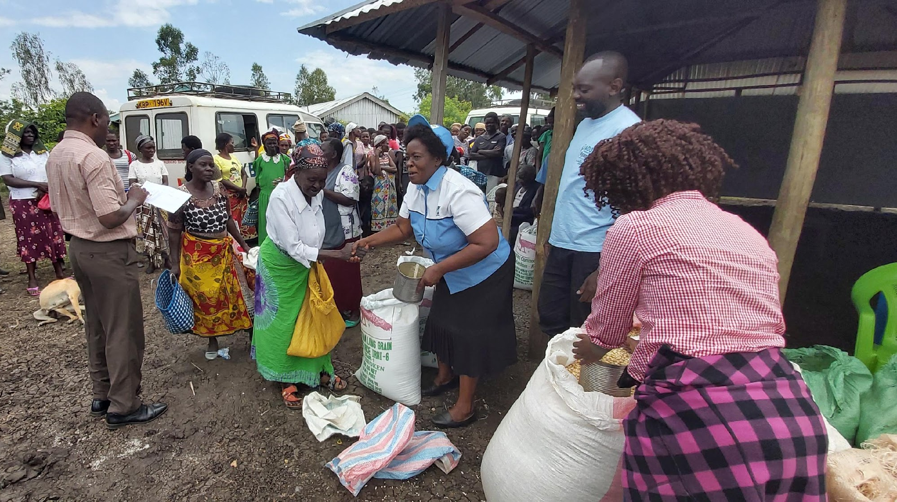
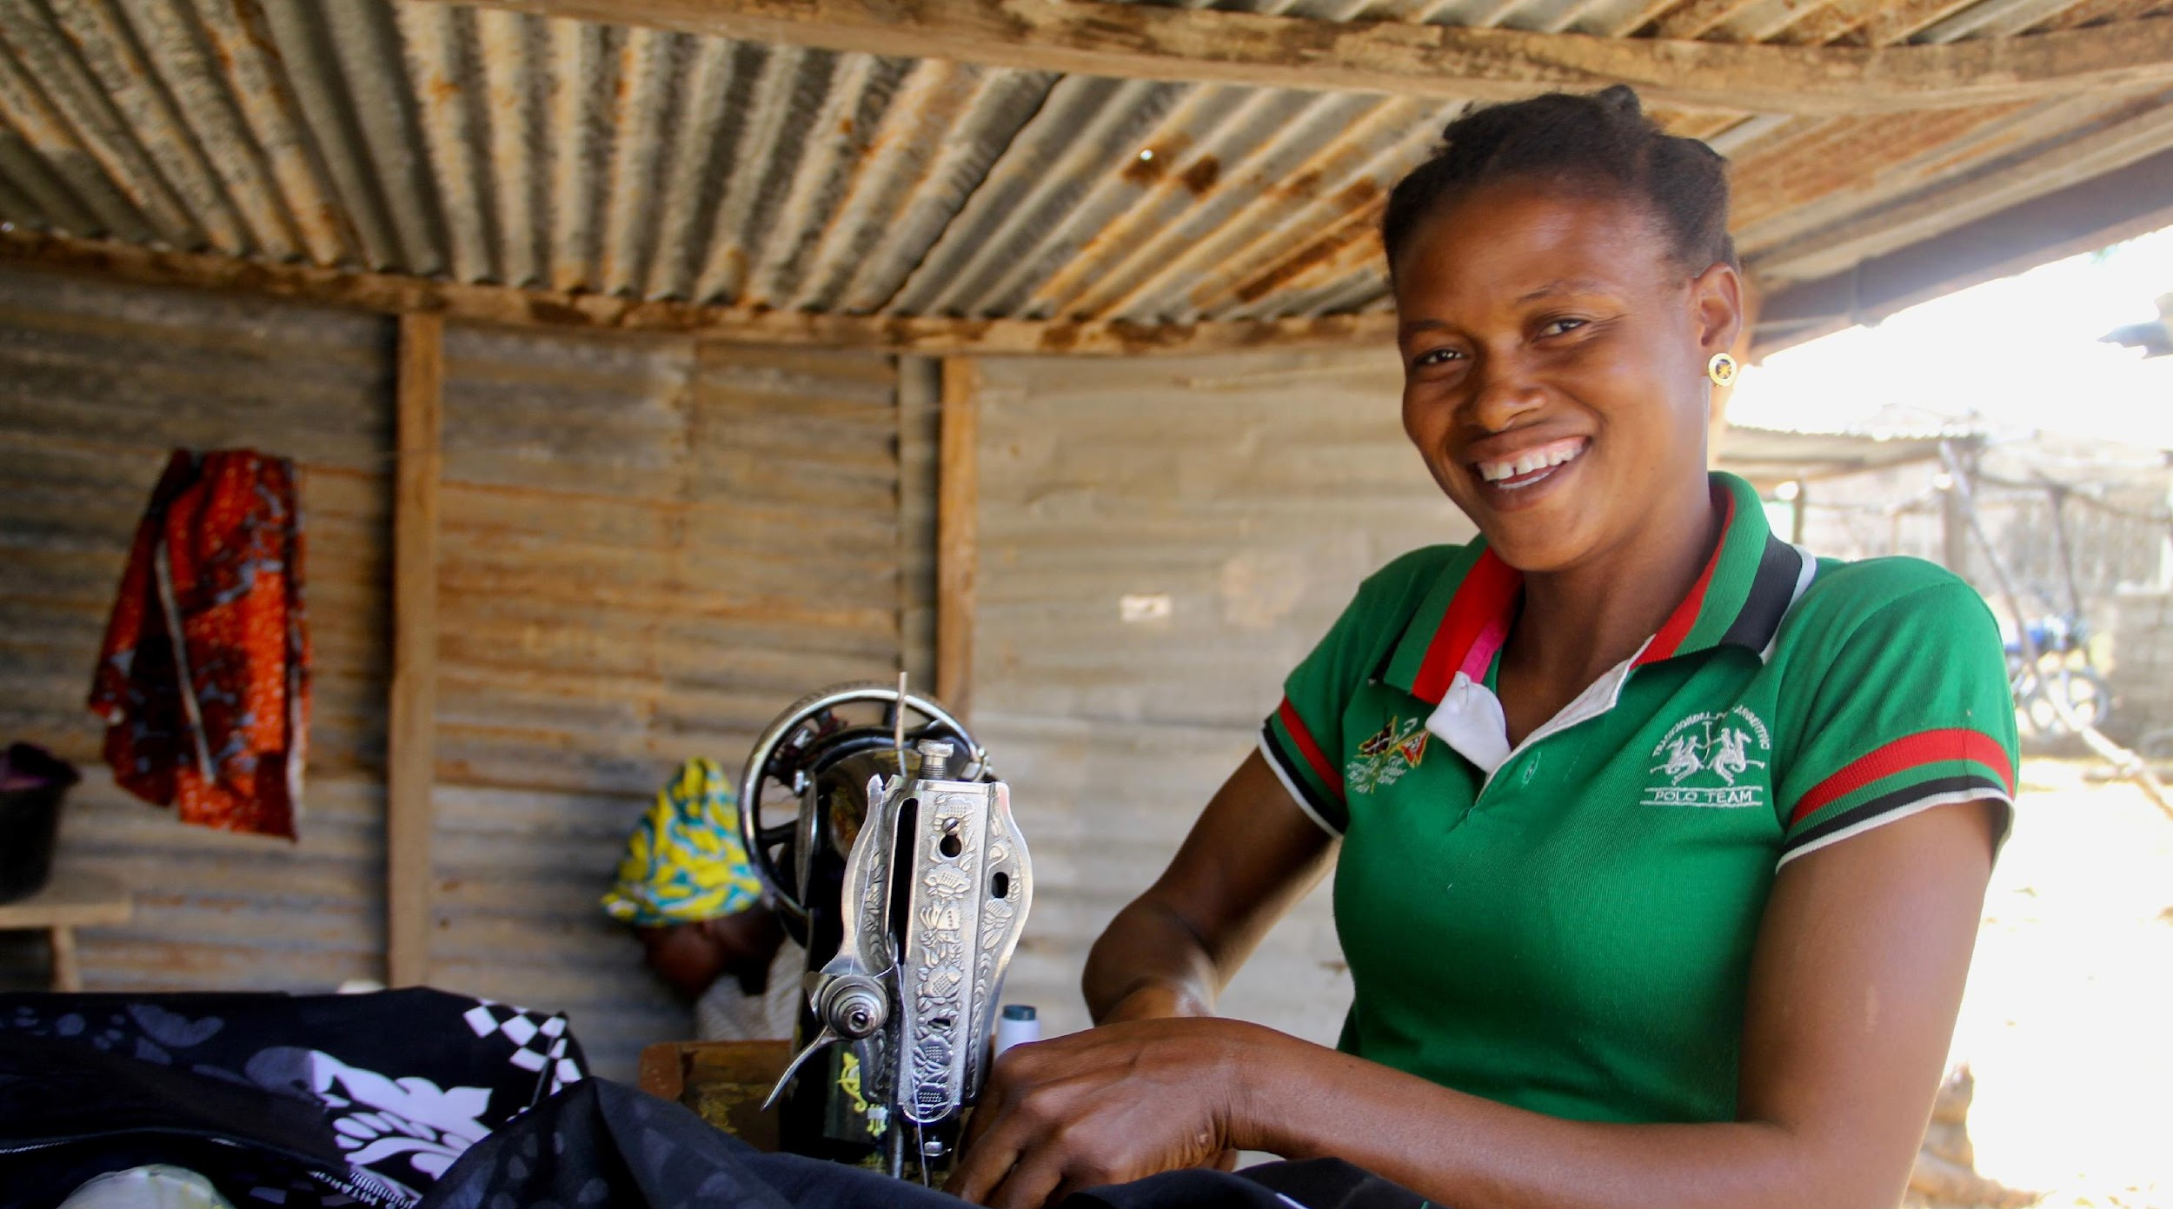
Group Rule of Life
Group Prayer
Guided Meditation
Intercessory Prayer at Home
Notes:
Leader: Explain that there are three ways in which the learning community will commit to a rule of life during the sessions. In other words, the sacred context of each session is understood to include prayer and meditation, together and at home.

Slide 5
We will explore the Episcopal Relief & Development priorities for Women and how we can apply them in our daily lives.
Every woman should live a life free from violence and be treated with dignity and respect.
There are often barriers to a woman’s growth and development, particularly the ongoing violence against women that takes place in many parts of the world.
Notes:
Leader: This session begins with a description of our topic. Read aloud or invite a reader.

Slide 6
Opening Prayer - Youth Session
We ask your blessing on this learning community, Loving God, that we may be attentive to the movements of your Spirit. Guide us as we grow to understand how we might participate in the global priorities of Episcopal Relief & Development to empower women, nurture children and meet the challenges of climate change and disaster resilience. We offer to you our open hearts and our desire to promote the dignity of all people. In your name we pray. Amen.
Notes:
Leader: In this Ritual of Dedication, invite online participants to light a candle, take some deep breaths, and pray the opening prayer aloud, together. (“Let us pray…”)

Slide 7
Opening Prayer - Adult session
Loving God, We ask your blessing on this learning community, gathered for mutual formation in the ways of love. Fill us with your Spirit, that we may open our hearts to the needs of women and children at risk, as well as the challenges of climate change and disaster resilience. Guide our efforts, we pray, as we discern what is ours to do in Your plan for human flourishing among all people. May we strive to be your Good News in the world. Amen.
Notes:
Leader: In this Ritual of Dedication, invite online participants to light a candle, take some deep breaths, and pray the opening prayer aloud, together. (“Let us pray…”)

Slide 8
Introductions
Share your name, [location], and one word for what is on your heart today.
Notes:
Leader: Invite each participant to share their name and a word for what is on their heart today.
Zoom group - If the group is 10+ you might invite participants to write this in the chat instead.

Slide 9
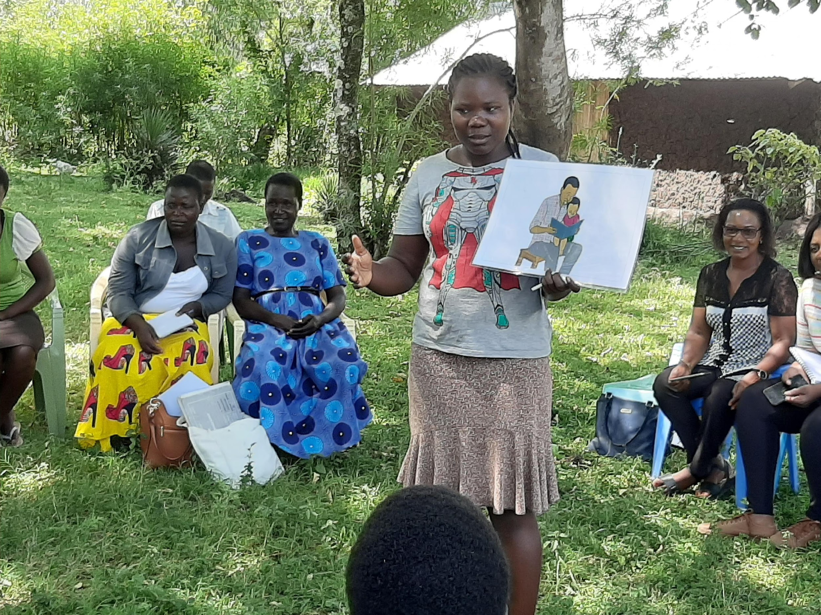
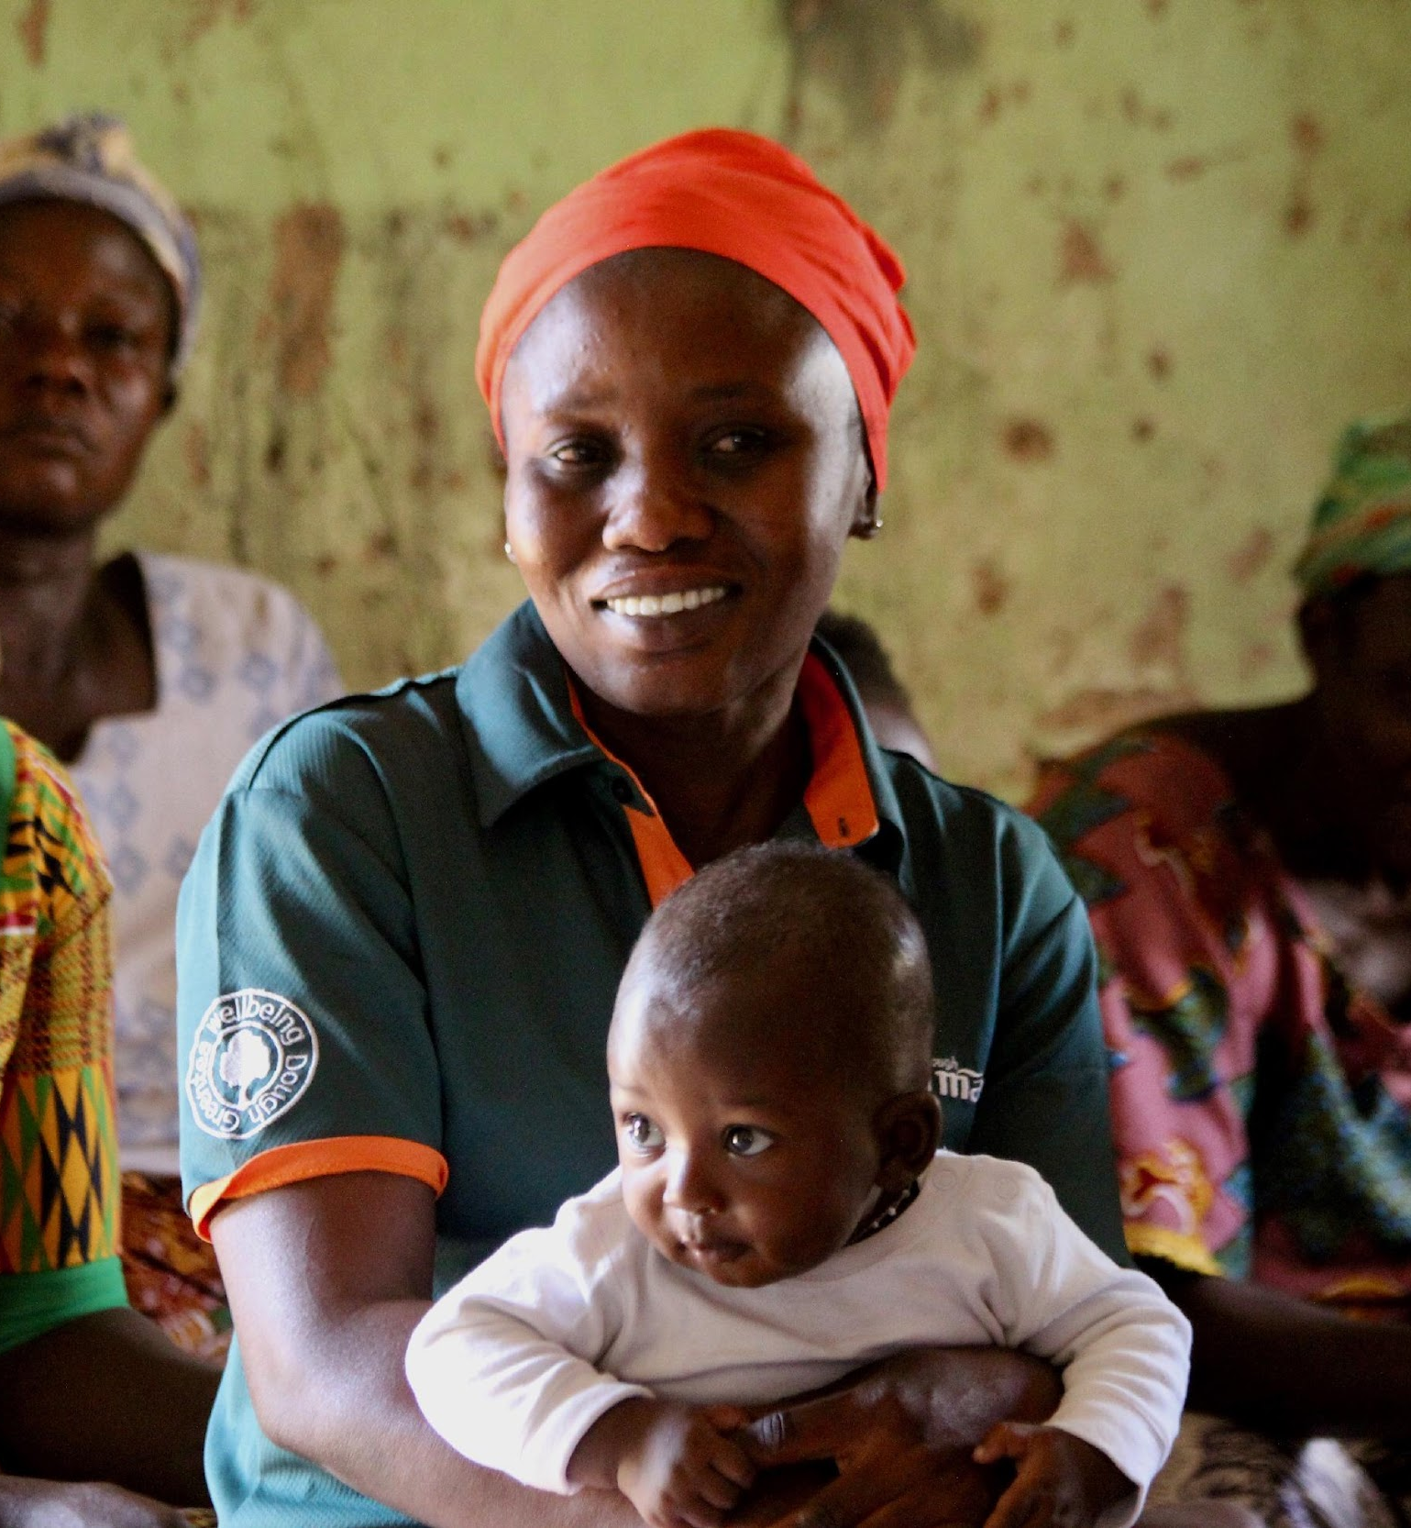
Scripture Reading
They are like trees planted along the riverbank, bearing fruit each season. Their leaves never wither, and they prosper in all they do.
Psalm 1:3 NLT
Notes:
Leader: Read the Scripture aloud.

Slide 10
Guided Meditation
Close your eyes or soften your gaze, which ever feels more comfortable for you.
Notes:
Leader: I invite you, now, to check that you are in a comfortable position, loosening and softening your body, as needed
Zoom group - invite group to turn off cameras, if they wish.
I invite you, now, to check that you are in a comfortable position, loosening and softening your body, as needed. You may close your eyes or soften your gaze, whichever feels more comfortable for you…Beginning to settle yourself [by noticing and putting aside any concerns, unfinished plans, or tensions from this day]...as we take the turn inward, putting ourselves in the presence of God… You may take a few long deep, cleansing breaths, tuning in to the movement of your breath collecting your attention…Breathing in the breath of Spirit, breathing out compassion and care…Breathing in the breath of the Spirit, breathing out welcome and generosity. When you notice thoughts or emotions arising, simply take note and then return your attention, very gently, to your breathing…there is no need to push thoughts or feelings away. Instead, maintain a posture of welcome to your own interior movements.
Continue attending to the breath as you join, in the silence of your heart, in these prayers for the healing of the world:
May we be in loving service to all.
May we be tenacious in humility and deeper understanding.
May we promote the dignity of every human being.
May we understand ourselves to be part of the natural world.
May all children be encouraged to grow and flourish.
May all women be encouraged to grow and flourish.
May we reverence God in all of God’s creation.
May all people find relief from struggle and pain.
May our compassion and hope radiate to all forms of life.
And may our faithful witness be for the healing of the world.
Continue breathing, imagining that with each exhale, you are widening your circle of concern, to include the whole world, from those closest to you to those furthest away.
When you are ready, set an intention for how you would participate in today’s session…and slowly return your awareness to this community gathered.

Slide 11
Learning Together
Notes:
Leader: This session we are exploring how the work of Episcopal Relief & Development empowers and promotes the rights of women that focus on four key areas.

Slide 12
The Lesson
Promoting Gender Equality
Creating Economic Stability
Cultivating Women Leaders
Ending Violence Against Women
Notes:
Leader: Read aloud

Slide 13
Promoting Gender Equality
Our work with communities focuses on how to balance the power structure between women and men, and encourage shared decision-making in household and other roles. We help ensure that women’s rights are recognized and protected and define specific actions that can address discrimination, violence and other forms of abuse. We also collaborate with local community members, faith leaders and other partners to integrate these strategies into all aspects of the lives of women and girls including their education, earning potential and health.
Notes:
Leader: Read or invite someone to read the description, here.

Slide 14
Creating Economic Stability
Data shows that when women have more financial earning power and the ability to decide how finances are managed, they bring positive economic change to the lives of their children, families and communities. Our programs encourage women to actively participate in financial decisions and to earn an income so they are able to provide food and health care for their families, as well as educate their children.
Notes:
Leader: Read or invite someone to read the description, here.

Slide 15
Creating Economic Stability
Women participate in Savings with Education (SwE) groups, which offer critical financial and business training as well as small business loans to individuals and groups. The SwE groups develop micro-insurance products, village banks and cooperatives for people without access to traditional financial markets and institutions.
Notes:
Leader: Read or invite someone to read the description, here.

Slide 16
Cultivating Women Leaders
When women take leadership roles, they can influence family and community life and encourage the equal distribution of resources. Our work strengthens and elevates women’s voices individually and collectively so that they become active in decision-making at a local and national level.
Notes:
Leader: Read or invite someone to read the description, here.

Slide 17
Cultivating Women Leaders
This shift plays a significant part in changing long-held attitudes, values and beliefs. We work with communities to ensure those in power are accountable to women. Our programs also invest in institutional change that supports transformative leadership positions for women and encourages them to serve as role models for girls.
Notes:
Leader: Read or invite someone to read the description, here.

Slide 18
Ending Violence Against Women
Violence has a devastating impact on family and community structures. By reinforcing existing inequality, it undermines the health, dignity, security and independence of those affected. It also greatly contributes to the cycle of poverty. Survivors, spouses and their communities work together to address trauma and promote healing, which leads them to become more resilient.
Notes:
Leader: Read or invite someone to read the description, here.

Slide 19
Ending Violence Against Women
We collaborate with local leaders to help prevent violence and respond to those impacted. In addition, we are contributing to research which highlights the ways that faith leaders can galvanize real social and cultural change. Our work engages community and faith leaders to take action and speak out against violence. Our programs play a pivotal role in creating interfaith networks which provide tools, skills and support for leaders to challenge the attitudes and behaviors that perpetuate injustice and discrimination.
Notes:
Leader: Read or invite someone to read the description, here.

Slide 20
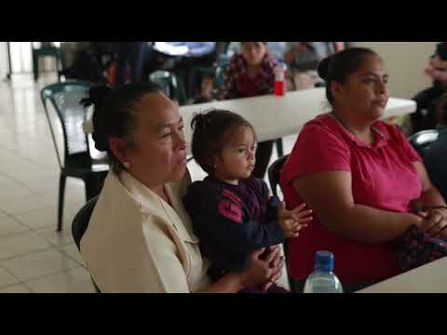
Instructional Video
Notes:
Leader: Let’s take a look at how these priorities play out on the ground and in community.
Note video is 3:42 minutes.

Slide 21
Using Mutual Invitation for Sharing
When Mutual Invitation is used, it encourages deep and holy listening to one another, because there is no conversation until everyone has spoken.
Notes:
In order to ensure that everyone who wants to share has the opportunity to speak, we will proceed in the following way:
1. The leader or a designated person will share first. After that person has spoken, he or she then invites another to share. After the next person has spoken, that person is given the privilege to invite another to share.
2. If you are not ready to share yet, say “I pass for now” and we will invite you to share later on. If you don’t want to say anything at all, simply say “pass” and proceed to invite another to share. We will do this until everyone has been invited.
The Mutual Invitation process is used in order to insure that everyone who wants to share has the opportunity to speak when the catalyst gives the instruction to do so. As group members become more accustomed to using this tool, they make connections with everyone in the session, because they invite each speaker by name.
When Mutual Invitation is used, it encourages deep and holy listening to one another, because there is no conversation until everyone has spoken once.

Slide 22
Questions for Reflection - Youth
What does this information have to do with me?
How does it challenge or inspire me?
What small step can I take in response?
Notes:
Leader: Offer your response first and then select the next participant to share (i.e., mutual invitation.)

Slide 23
Questions for Reflection - Adult session
What moved you in your learning?
Did it stretch or challenge you in some way?
How might your new learning change who you are becoming as a Christian disciple and enrich or equip your witness?
Notes:
Leader: Offer your response first and then select the next participant to share (i.e., mutual invitation.)

Slide 24
Group Reflection/Brainstorm
What would support your ongoing formation in this area?
Notes:
Leader: Invite the group to brainstorm ideas for ongoing learning and action (popcorn style.)

Slide 25
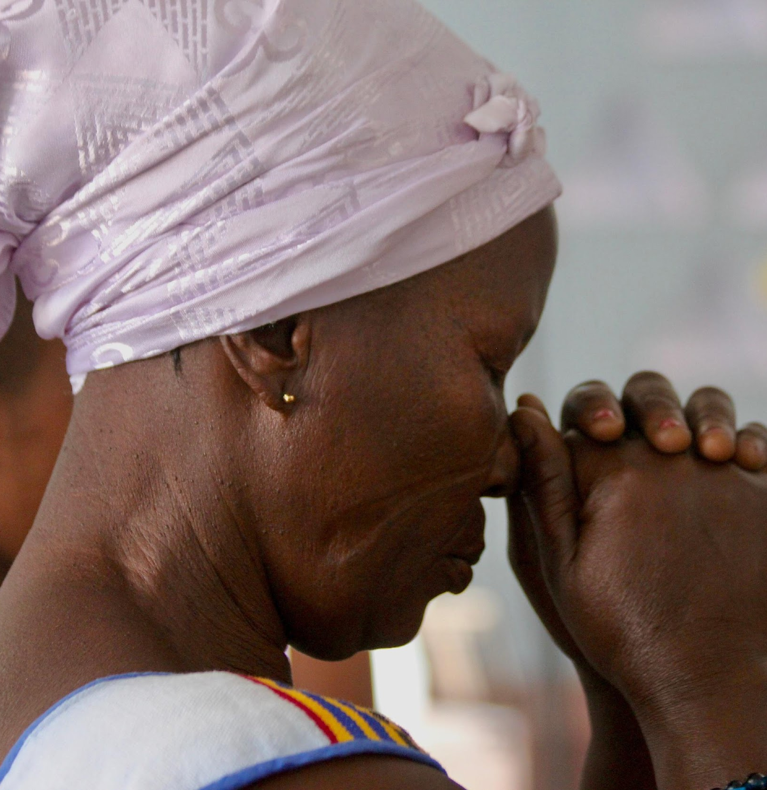
Pray in this coming week for the people we met today and for one another in this Community of Learning.
Let us pray.
Notes:
Leader: Remind group of their commitment to ongoing prayer (Rule of Life.)

Slide 26
Closing Prayer
Loving God, We thank you for drawing us into the work of justice and flourishing, envisioned by Episcopal Relief & Development.
We ask your blessing upon this learning community,
seeking to grow in understanding and commitment.
Guide us, we pray, to walk in your way, so that we may embody the world that we deeply desire and long for.
Bless our loving actions in our daily lives, our families and partnerships, our communities and connections,
for the Family of God and for all of God’s creation. Amen.
Notes:
Leader: Invite participants to pray together.

Slide 27
At Home
Choose one or more links to explore the topic more deeply:
Art
Music
Ted Talk
https://bit.ly/3kYB5gj
https://bit.ly/3M3UQig
https://bit.ly/3srRGx7
Notes:
Leader: Encourage participants to discover additional online resources in their favorite learning modalities.

Slide 28

Notes:
Leader: Thank you for your participation and support of this important work. This curriculum was developed as part of the ONE THOUSAND DAYS OF LOVE campaign.

